Slide 1
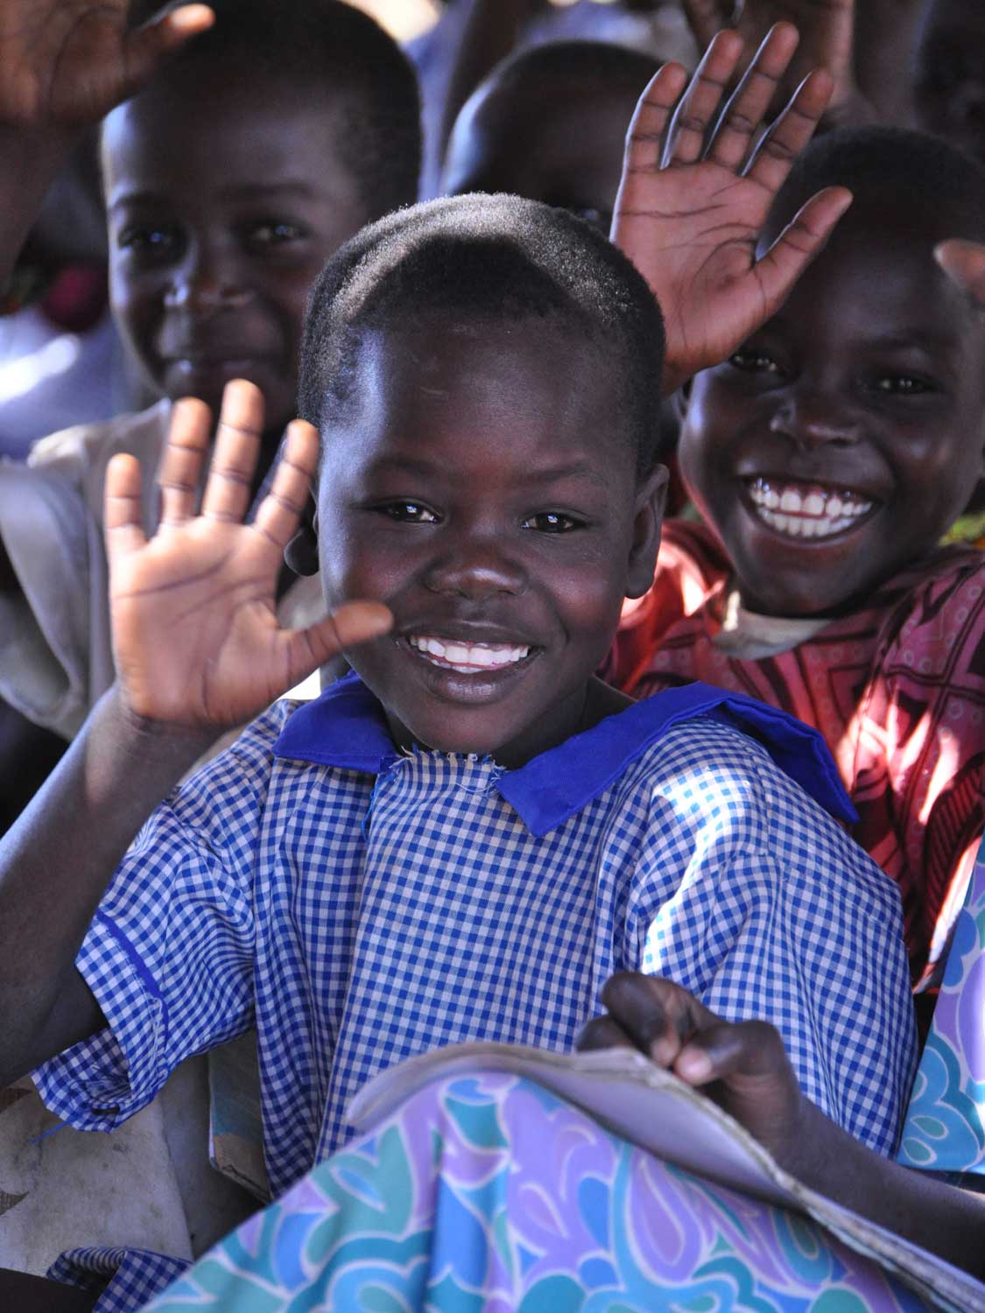
Jambo!
Hello!
Notes:
Build Africa Presentation for Parents and Teachers
June 2013
‘Jambo’ is how to say ‘hello’ in Swahili.
Swahili is one of the official languages in Kenya and Uganda. English is the other official language.
This presentation will give parents, governors and teachers an introduction into who Build Africa is and the work that we do.

Slide 2
Who we are
Established 1978 - 35 years International Development experience
Focus on sustainable, community led development
2011 shortlisted for the Charity of the Year award and voted Best Charity to Work For at the Charity Times Awards
2012 winner Charity Times Award for Best International Charity
Notes:
Build Africa is an award winning charity with more than 30 years experience in International Development.
With our local partners Build Africa Uganda and Build Africa Kenya we work directly with communities to provide long term solutions to tackle poverty.
Our aim is not just to support schools, but to develop a sustainable model which can continue working without us, gives every child access to a good education and becomes the focus of community life.

Slide 3
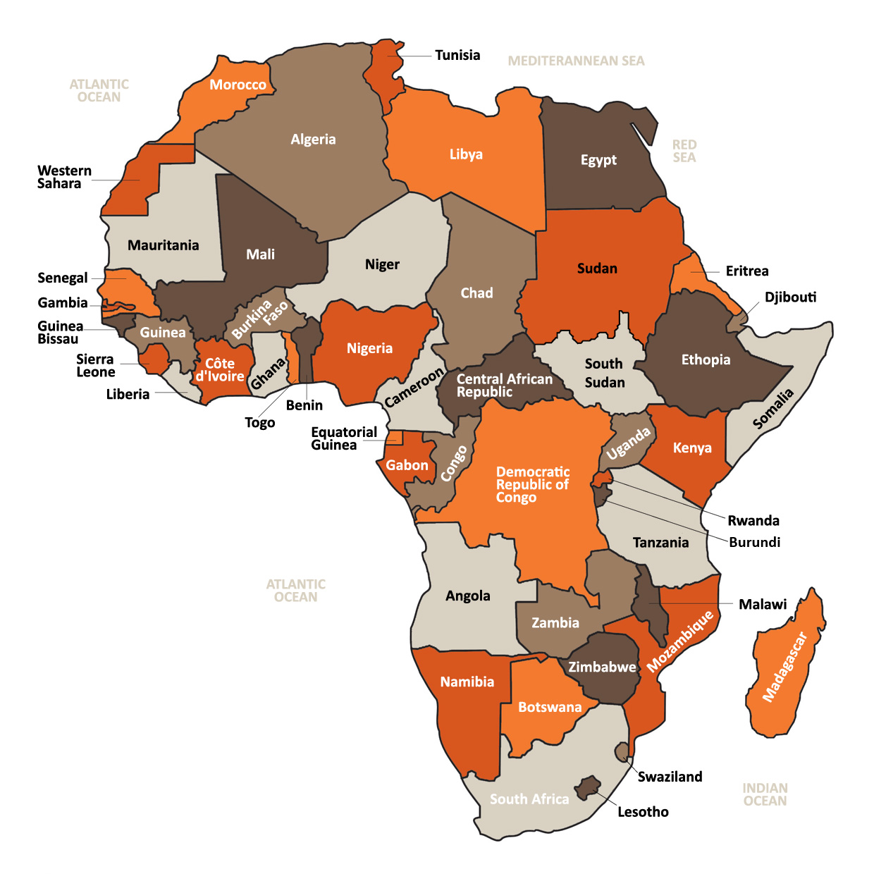
Uganda
Kenya
Build Africa work directly with communities in rural areas of Uganda and Kenya to provide long term solutions to tackle poverty

Slide 4
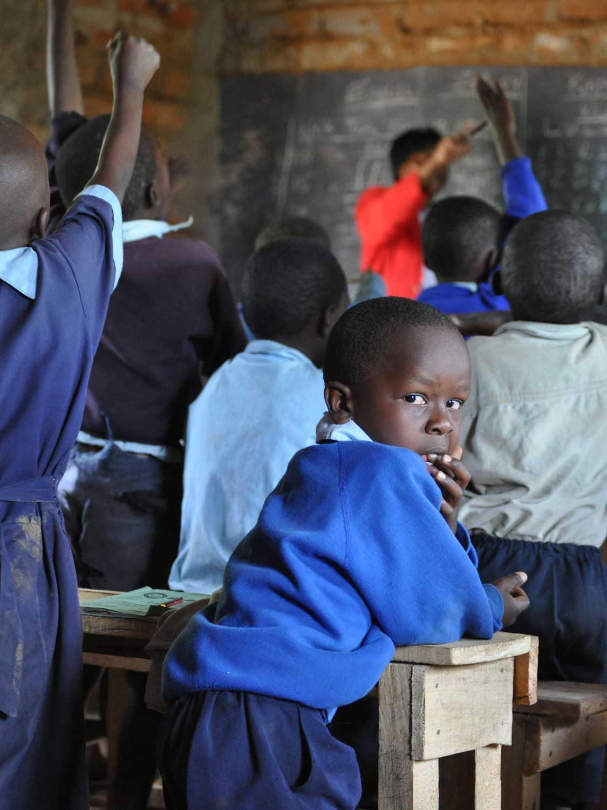
Since 2004 our Build a School programme has worked in partnership with 100 primary schools benefitting more than 150,000 children
Notes:
Build Africa’s involvement with a school encompasses the entire community and encourages empowerment and ownership by both students and parents for a long time to come.
By supporting a school for at least 7 years, and monitoring it until it is financially self-sufficient, Build Africa can give the school the best possible chance that once the opportunity of education has been provided, it is not taken away.

Slide 5
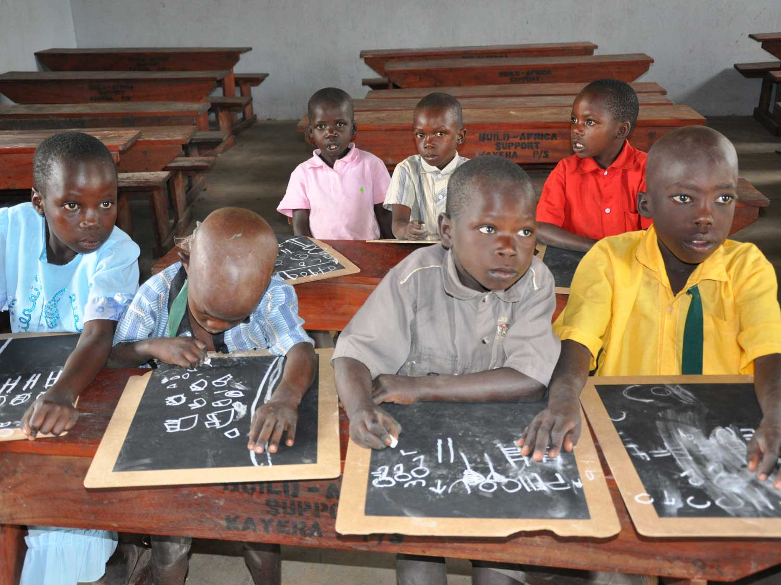
In Uganda, 94.5% of students in schools we have been supporting
for 5 years or more pass their final exams, compared to 79.3% in
the schools we have just recently started supporting

Slide 6
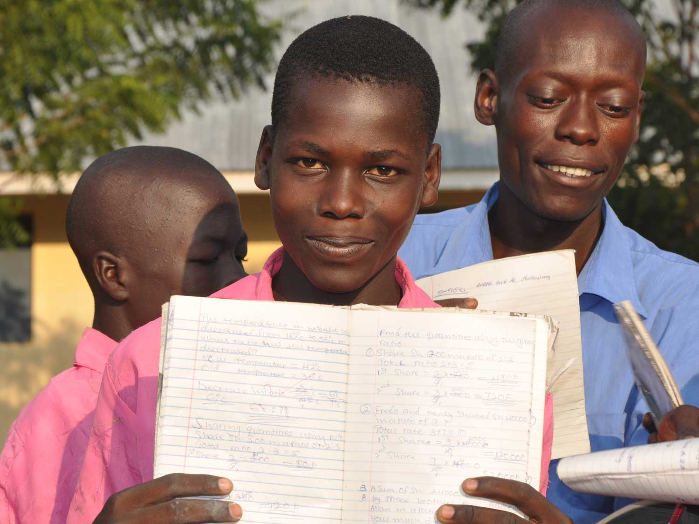
In Kenya, the average number of students per school taking
their leaving exams has more than doubled in schools we've
been working with for two years or longer

Slide 7
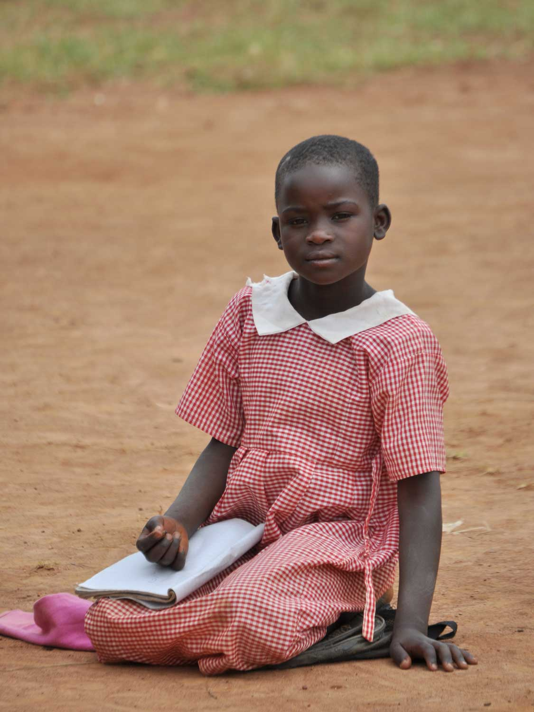
The majority of poor children in rural Kenya
and Uganda cannot
access the education
they deserve
Every day a child’s
potential is wasted
Key issues facing rural communities
Notes:
We work in the most isolated schools, which government bodies often find hard to reach.
The introduction of free primary education in both Kenya and Uganda some years ago resulted in massive increases in enrolment. However, this was not matched by an increase in resources.
According to a recent government survey, 16.5 million Kenyans - over half the entire population - live below the poverty line. Approximately 60% of Kenya's population is comprised of persons under the age of 30. Most of them are either in school or not gainfully engaged after school since long term unemployment is high.
Schools are completely overstretched and there is a serious shortage of teachers, which leads to poor quality education and a low level of literacy among school leavers.
In Uganda 35% of its population live below the poverty line and the average daily Ugandan income is £2, compared to £40 in the UK. Improved education is a priority of the Ugandan government. In 1997 Universal Primary Education (UPE) was introduced, with enrolment rising from 2.5 to 6 million pupils. in 2007 the government went one step further and made secondary education free. While it is now the single biggest item in government spending, finances are limited and schools are desperately under funded. One in five primary school children are orphans and the image of large classes held in the open is a common one in rural Uganda.

Slide 8
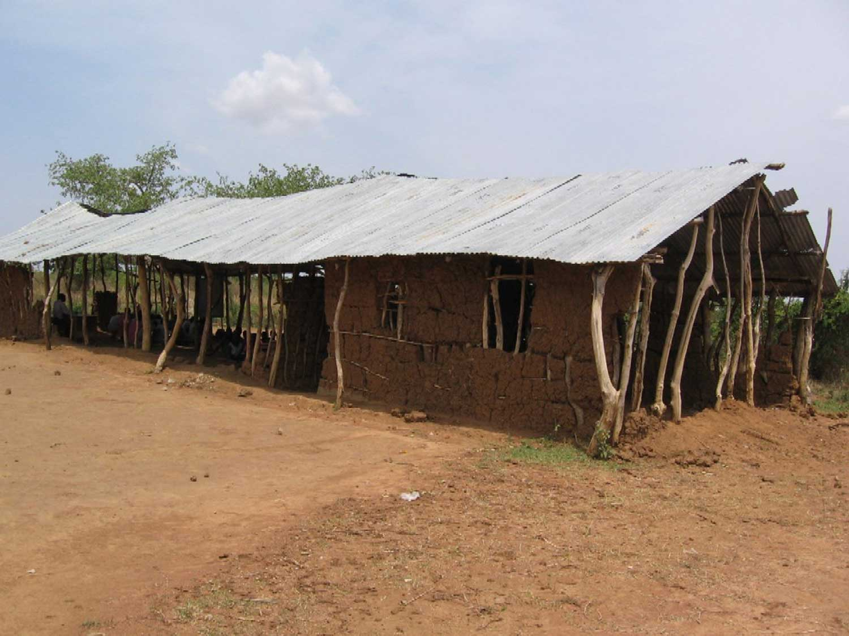
Children who are not sent out to work have to
learn in dilapidated, leaking or unsafe classrooms
Notes:
It is vitally important that a school has safe, purpose-built classrooms that provide both pupils and teachers with shelter from the elements, enabling lessons to continue uninterrupted.
With many of the schools we partner, we first find them holding classes outside under the shade of trees or in make-shift structures, exposing children – and the few books they have – to the elements.

Slide 9
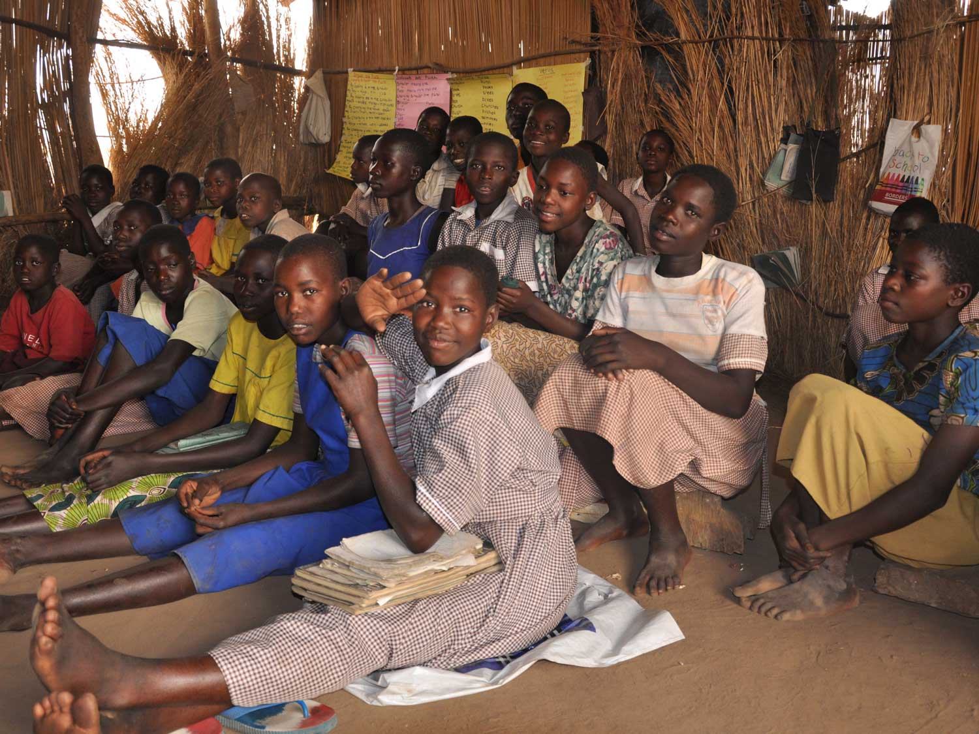
They have to contend with overcrowded conditions
Notes:
To have children sitting comfortably at desks is a crucial component in improving the environment in which they learn.
With Government budgets overstretched in both Kenya and Uganda, there are just not enough classrooms with the space to accommodate the numbers of children needing to be off the ground and seated properly, attentive and ready to learn.

Slide 10
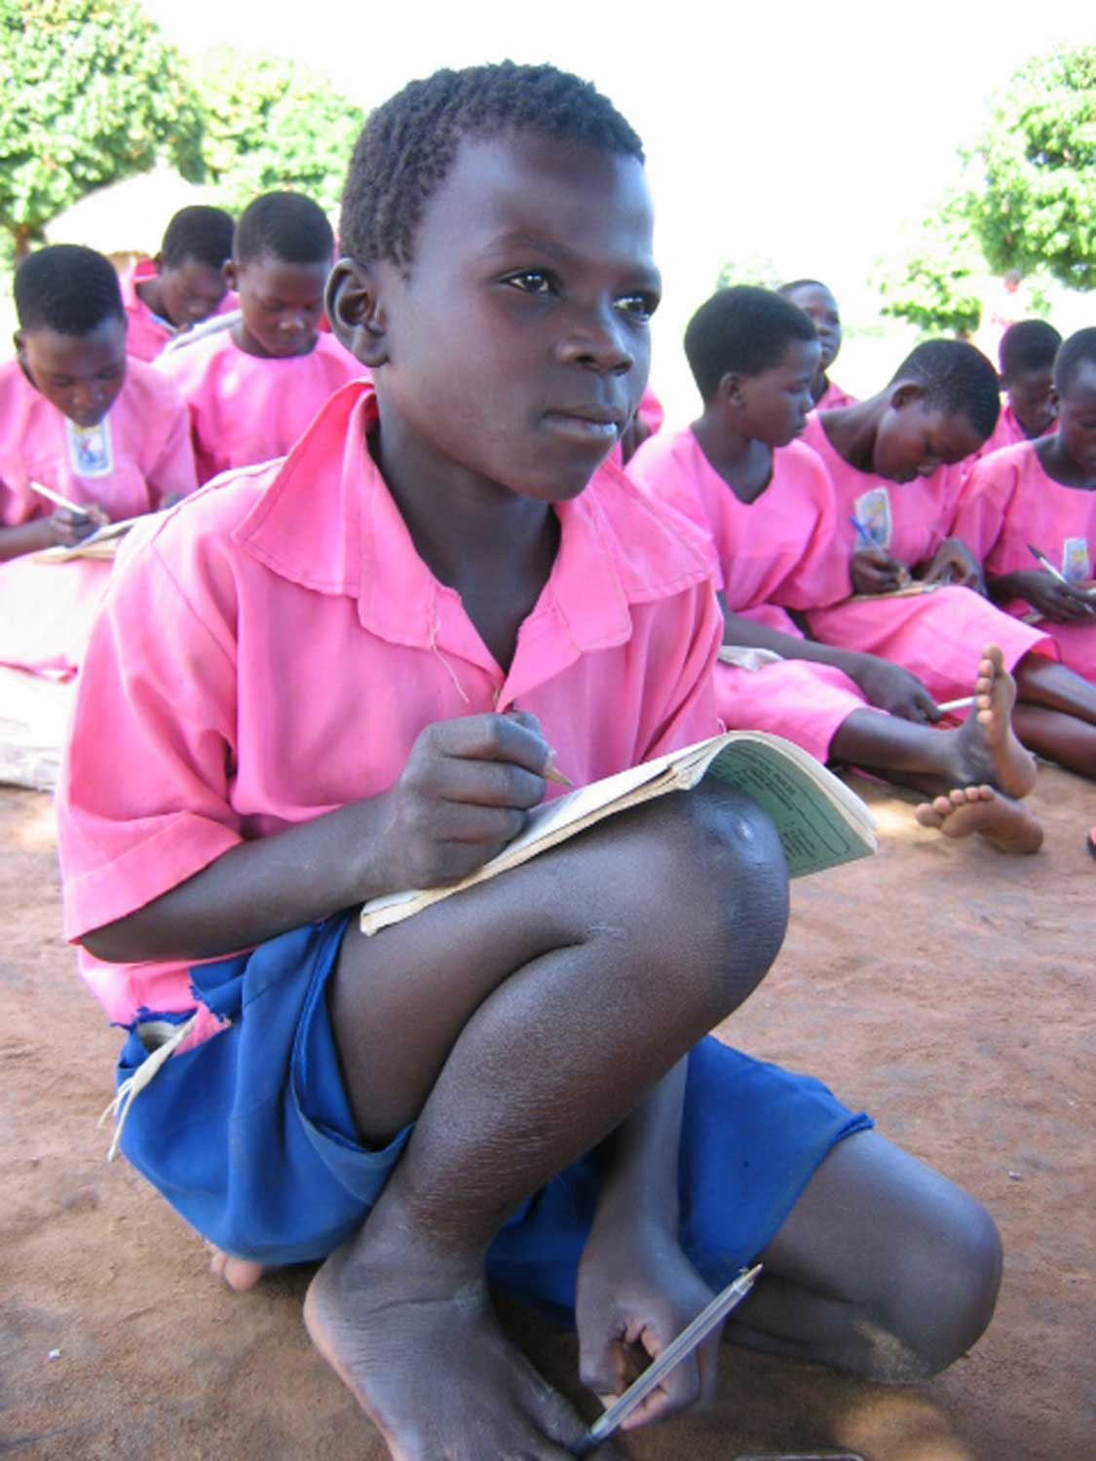
Few or no desks
Notes:
Many children at the schools we work with have no choice but to sit on the ground or the dusty floor because there are not enough desks – or simply none at all.
The lack of desks means children sit uncomfortably on the ground making concentration and writing difficult and uniforms very dirty.
In these conditions pupils are ill-prepared for exams.

Slide 11
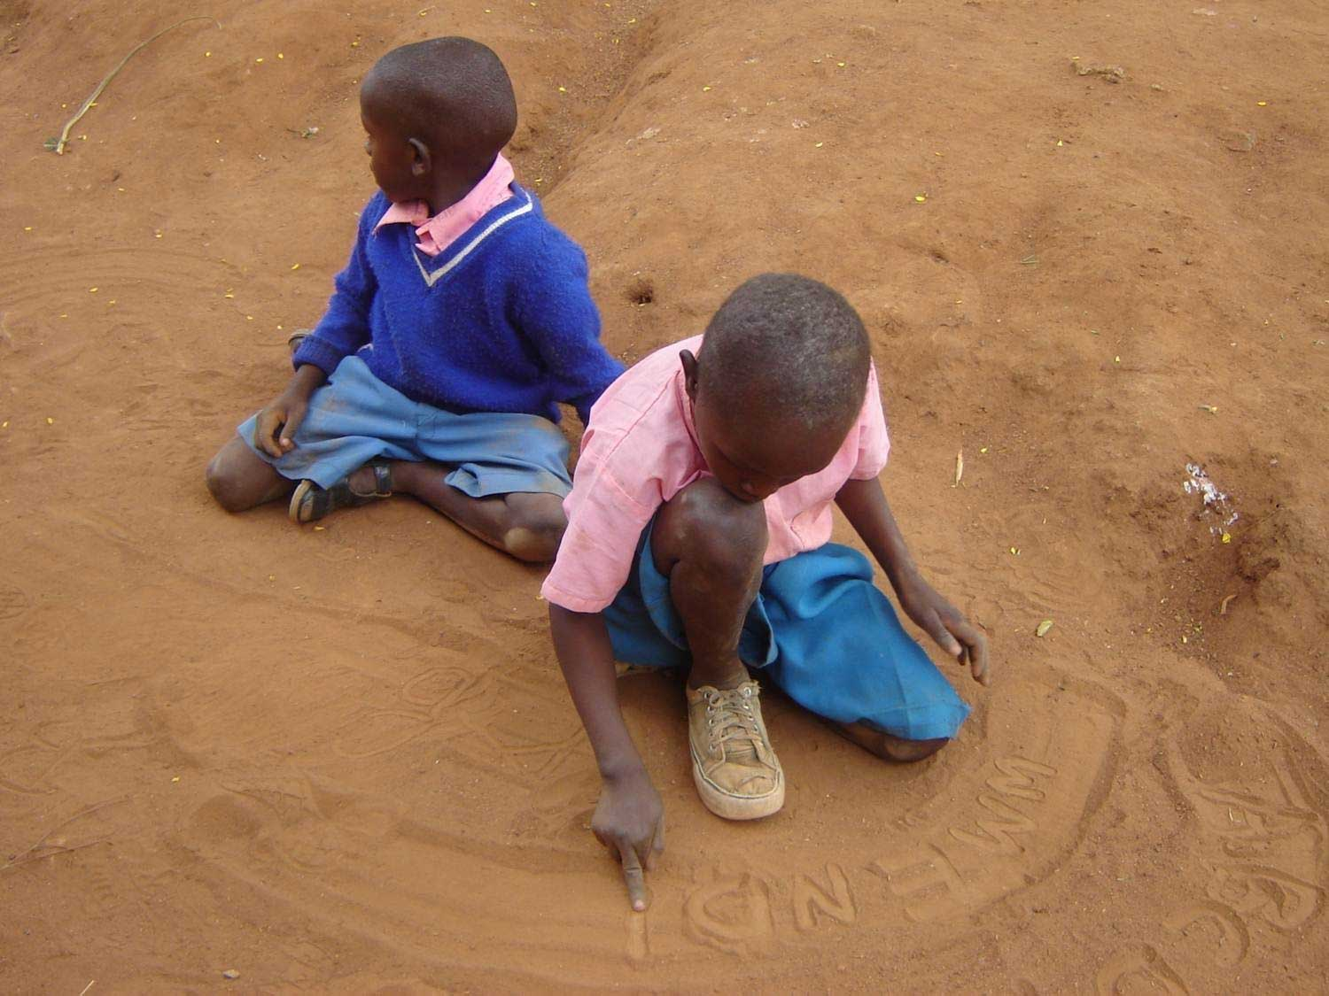
And a lack of books and other learning materials
Notes:
Good teachers require adequate teaching materials in order to deliver their message effectively to their pupils.
A lack of learning aids has a direct impact on the quality of education children are receiving.
And the lack of text books means many children are unable to follow lessons.

Slide 12
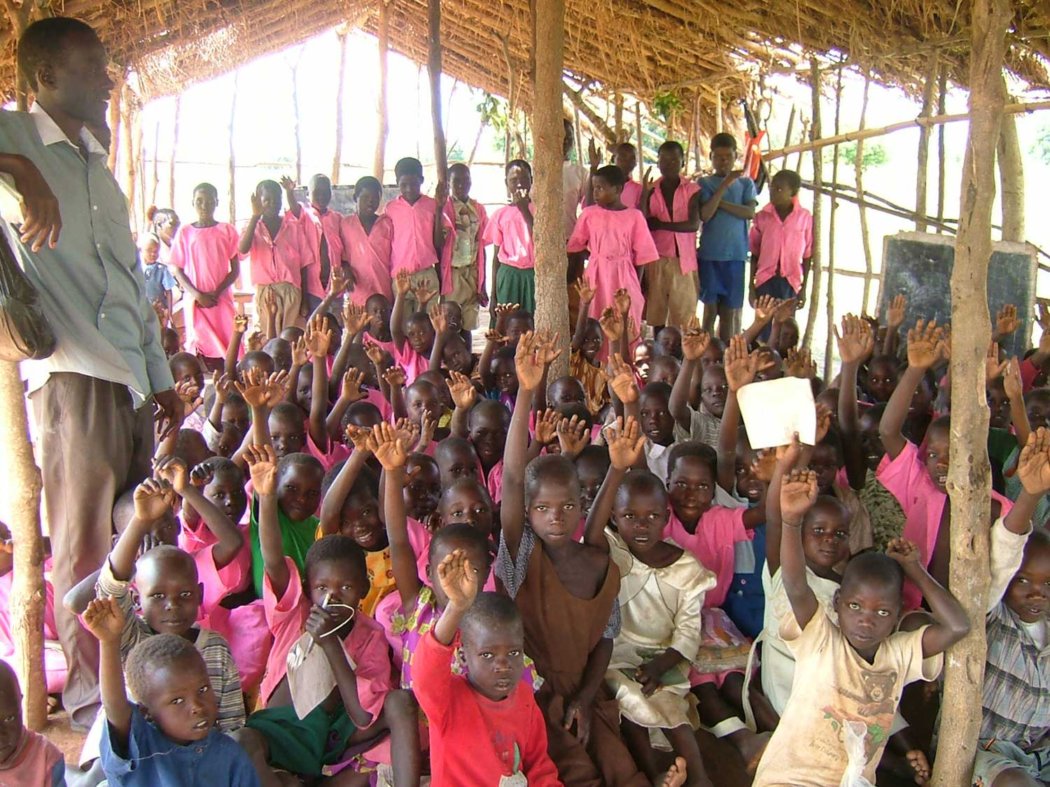
Added to this are poor and out-of-date teaching methods,
as well as too few teachers for the number of students
Notes:
Once again inadequate Government funding means teachers are poorly trained, and a lack of refresher teacher training results in lessons being conducted using old fashioned rote learning. New teaching methods and techniques are not applied as teachers are not trained.
In poor and remote communities, and with minimal resources, teachers are isolated and do not get the opportunity to visit and learn from good schools in the region.
Pupil - teacher ratio in Kenyan primary schools : 46.78 *
(drops to 29.68 in secondary schools) *
Pupil - teacher ratio Ugandan, primary schools: 49.28 *
(drops to 17.91 in secondary schools) *
* World Data Bank 2009

Slide 13
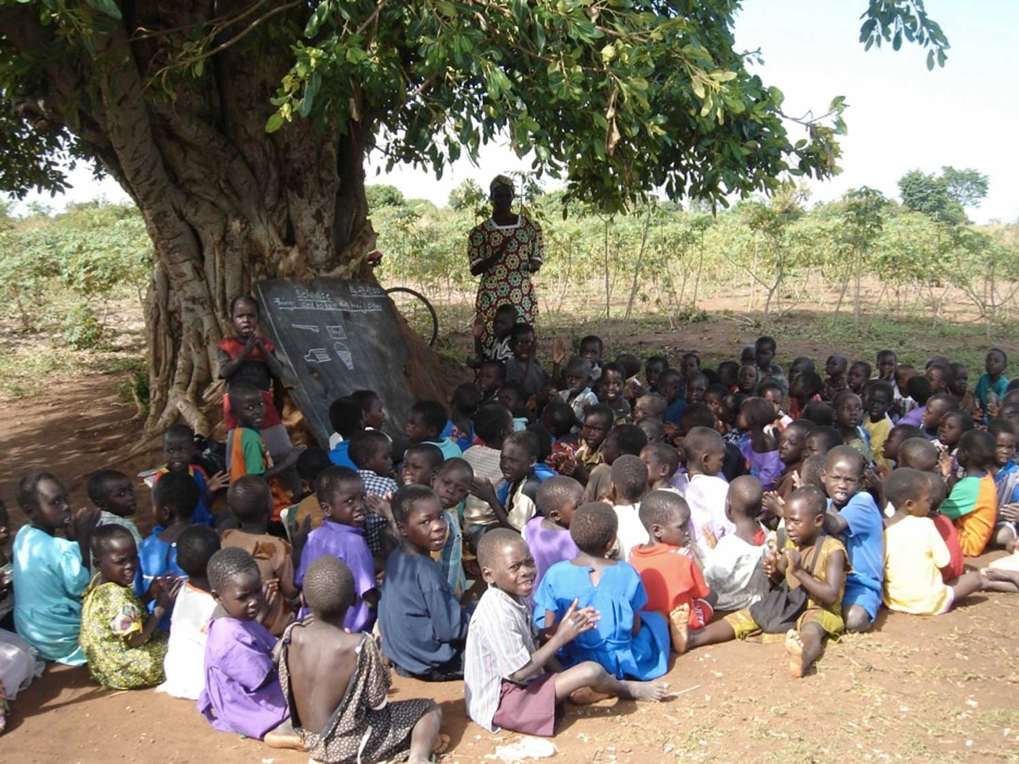
A lack of classrooms, little parental or community involvement
and limited management experience
Notes:
Quite often, a lack of pre-school classrooms means that the youngest children have to study under trees or in dangerous structures.
Classes that are held outside miss an average 25% of their school days every year because when the rains come, children are simply sent home.
Not having had a quality education themselves, most parents do not know the value of education and are not involved in the education of their children. Without training the school community does not hold authorities accountable for education quality.
And a lack of knowledge and training means parents are unable to support school development or access the resources they're entitled to.

Slide 14
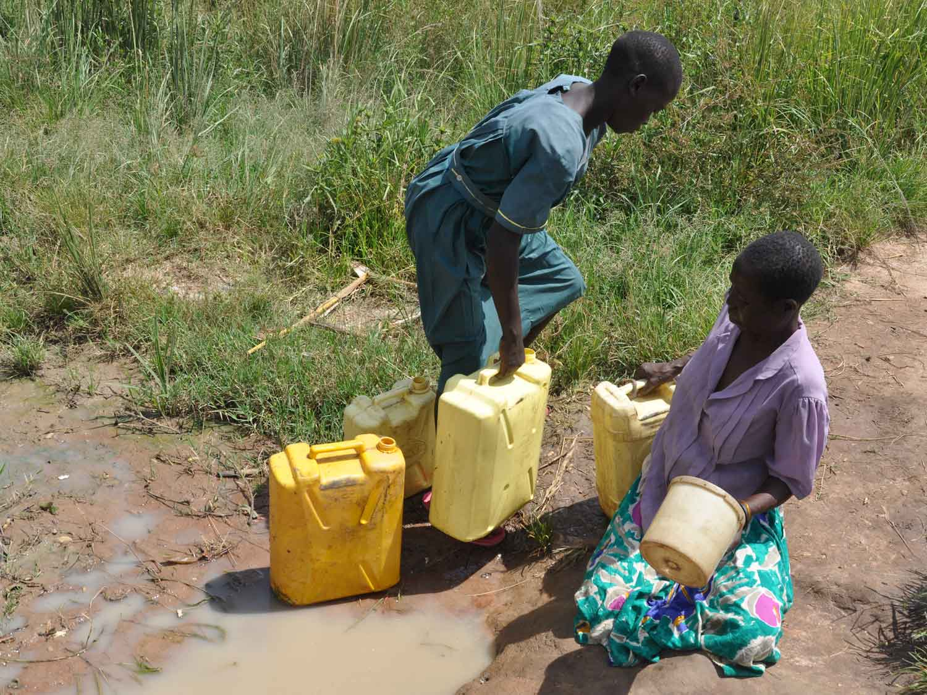
Further issues include a lack of clean and safe water
Notes:
Poor and remote villages of Kenya and Uganda are badly affected by the lack of clean, safe water. Many people often get their water from streams and rivers that are used for drinking as well as washing, cleaning and irrigation. They are, more often than not, contaminated with excrement, making them breeding grounds for harmful bacteria and disease.
Almost half of all Africans suffer from one of six main water-borne diseases*, the most prevalent ones being diarrhoea and cholera.
Most schools do not have drinking water either, meaning pupils have to walk long distances to collect it or lack drinking water for the entire day.
An estimated 50,000 defective water supply installations exist in Africa, representing an investment of US$215-360 million (IIED 2009). Examples of poorly maintained, dilapidated water infrastructures contaminated with soil and faeces bringing disease to rural communities are common.
This situation occurs because donors, governments and NGOs build water points without engaging the community in discussion or investigating the cost of keeping boreholes clean and functioning in the long term. Once constructed, boreholes fall into disrepair because the local community is unable to afford the maintenance costs. If the community has the skills to undertake the repair, spare parts are often not easily available and an external mechanic is too expensive.
* Africa Water Vision 2025

Slide 15
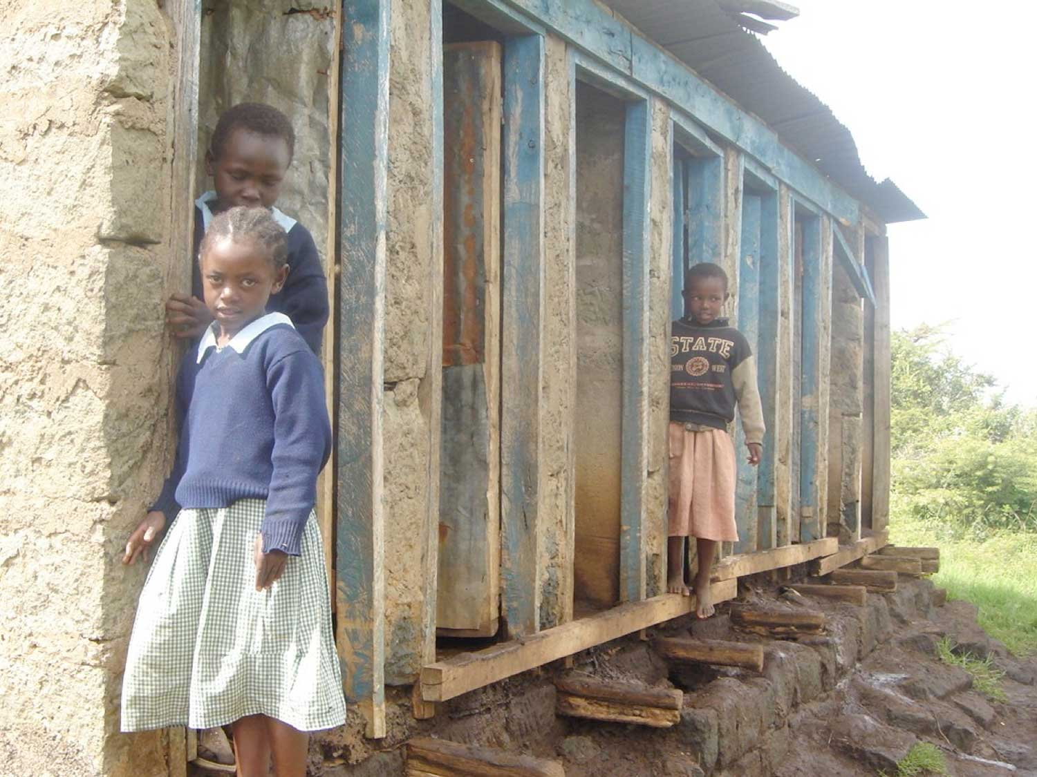
Inadequate knowledge of health issues by students,
parents and even teachers
Notes:
A general lack of knowledge about health and hygiene issues contributes towards high levels of illness and children miss a lot of school, which means academic performance remains low.
A lack of sanitary protection often forces older girls to drop out of school as they do not have the privacy they require as they get older. Teenage girls miss on average five days of school per month due to menstruation as families are simply unable to afford sanitary protection for them.
There are too few toilets and the existing facilities are dangerous for small children. Many children are forced to use the bush and pupils are unaware of the importance of hand washing to avoid illness. Hardly any schools have clean water for hand washing, especially if using the bush.
Teachers are not trained in the issues surrounding child protection, gender or disability.
In many schools there is also a lack of opportunity for children to play sports and games, which are important for boosting school enrolment and attendance. Sports and games are also important in improving health and fitness, as well as teaching children vital life skills such as teamwork and leadership.

Slide 16
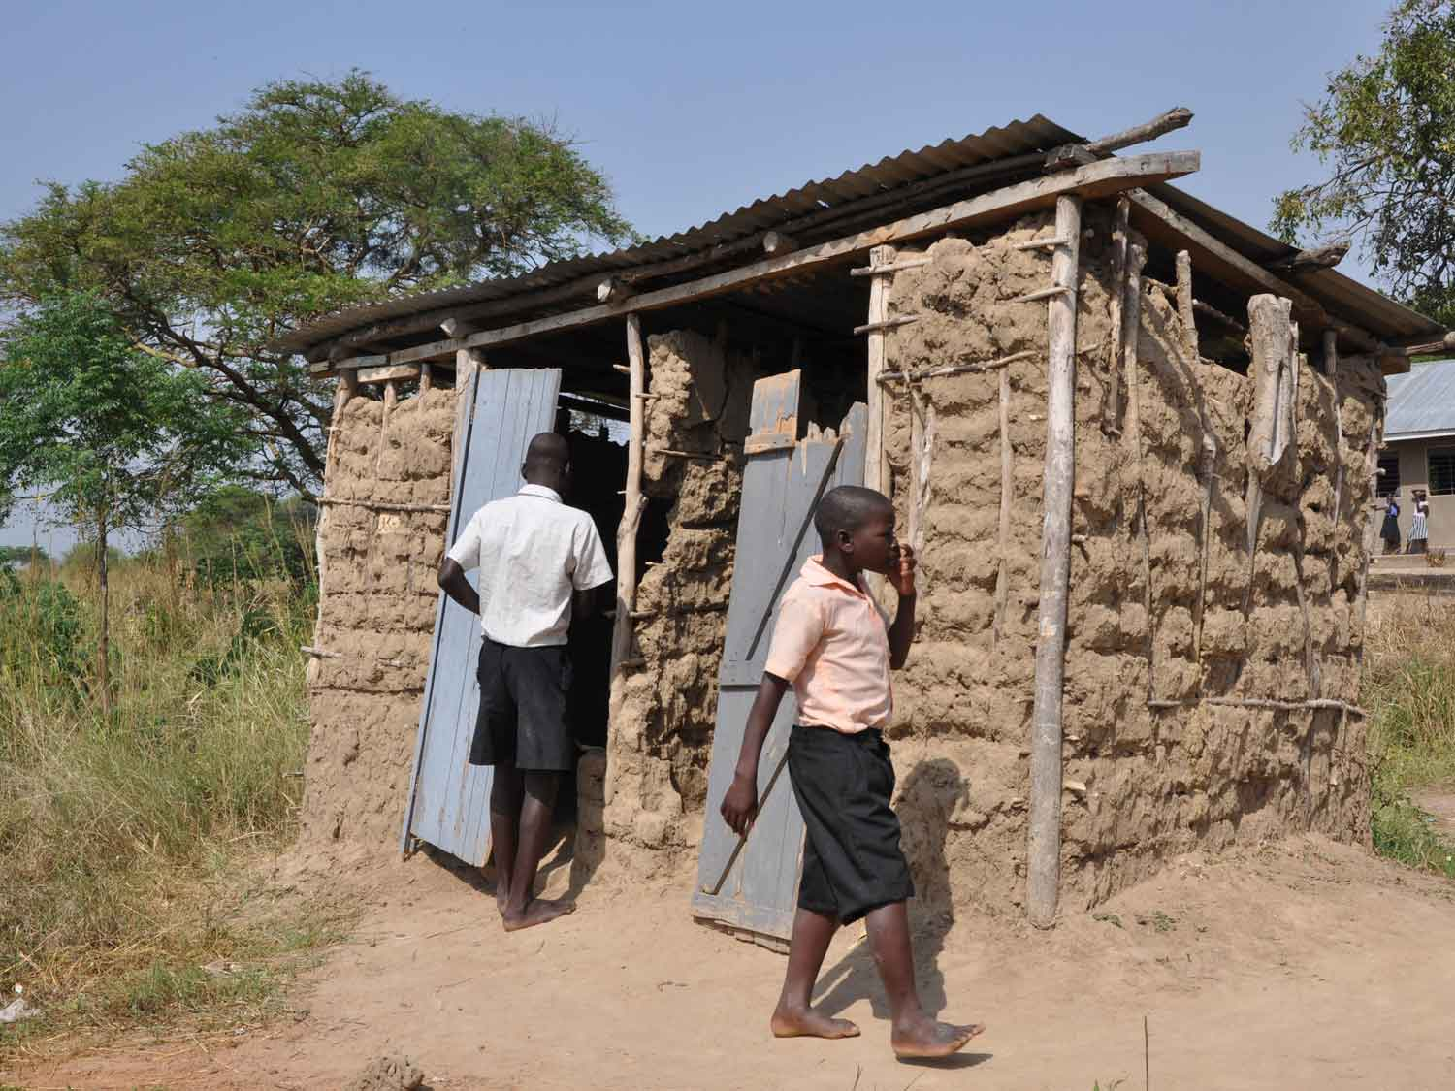
Poor and inadequate toilets – in some schools
no toilet facilities at all
Notes:
Most of the sanitation facilities at the schools we support are extremely poor and there are frequently no separate toilets for boys and girls. Typically, there are as many as 99 children per latrine stance, far exceeding even the national recommended average of 16:1.
Existing facilities are dilapidated, unsafe and unhygienic. Many children are forced to use the bush.
Illness, due to poor sanitation, is a huge cause of absenteeism. In addition, many older girls drop out of school because poor toilet facilities mean that they do not have the privacy they require, especially at certain times of the month. A lack of sanitary towels also means girls can't attend school during their period.
In Uganda, only 20% of schools have hand-washing facilities next to toilets. This means that infections and diseases spread relatively easily.

Slide 17
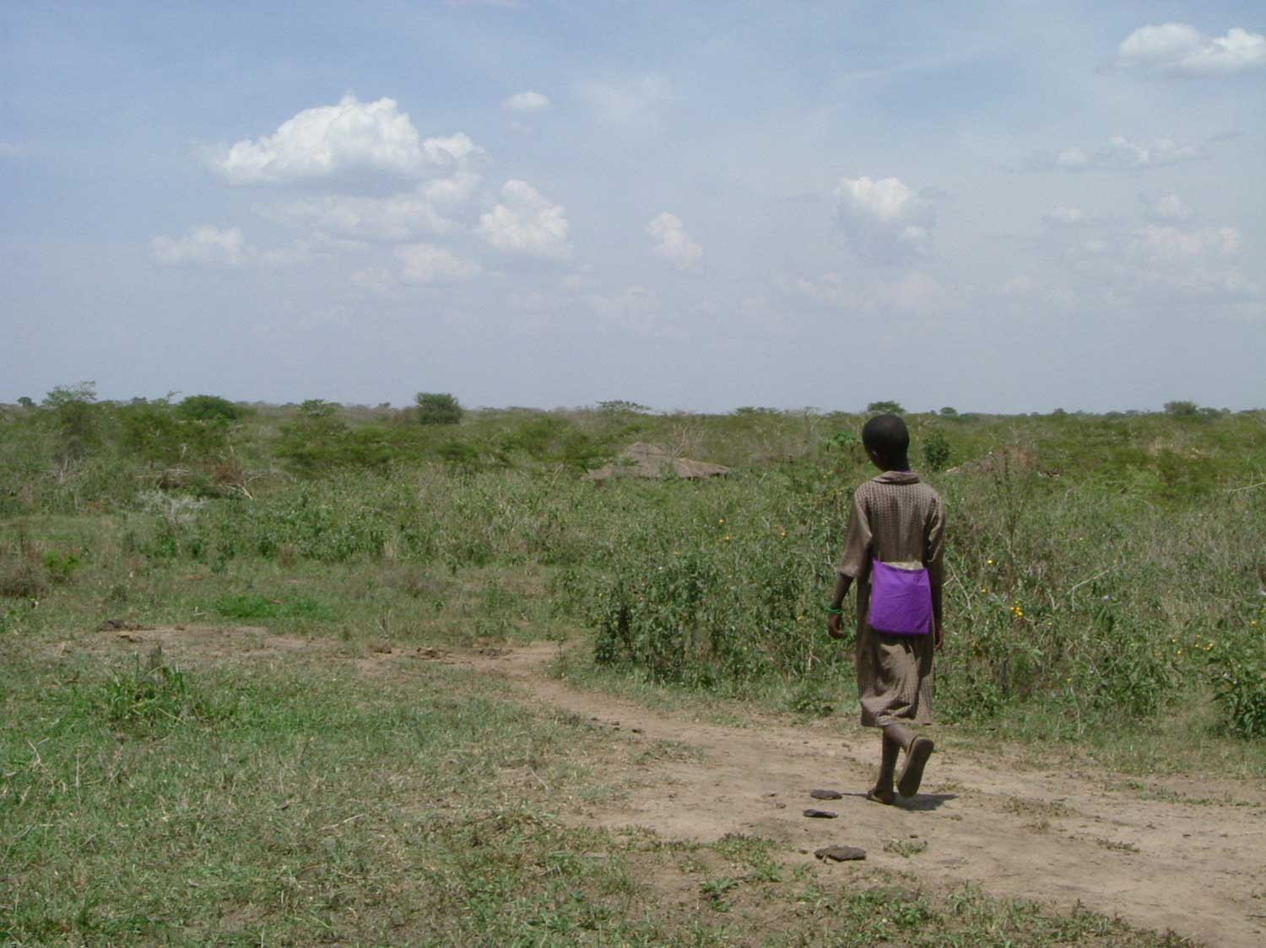
And many children going hungry as their parents are
unable to provide three meals a day
Notes:
One of the key issues facing poor rural communities in Kenya and Uganda is the daily struggle to put enough food on the table each meal time. Many children go hungry as their parents are unable to provide their children with three meals a day and a lot of schools simply don't have the means to provide lunch for pupils.
Many children will actually miss school in order to earn money or take part in subsistence farming activities so their families have enough food to survive. Some children receive as few as half the calories they need. This makes them more vulnerable to infection and leads to increased absenteeism and poor academic results.
Additionally, a lack of food during the day leaves pupils lethargic and unable to concentrate which again, affects academic performance.

Slide 18
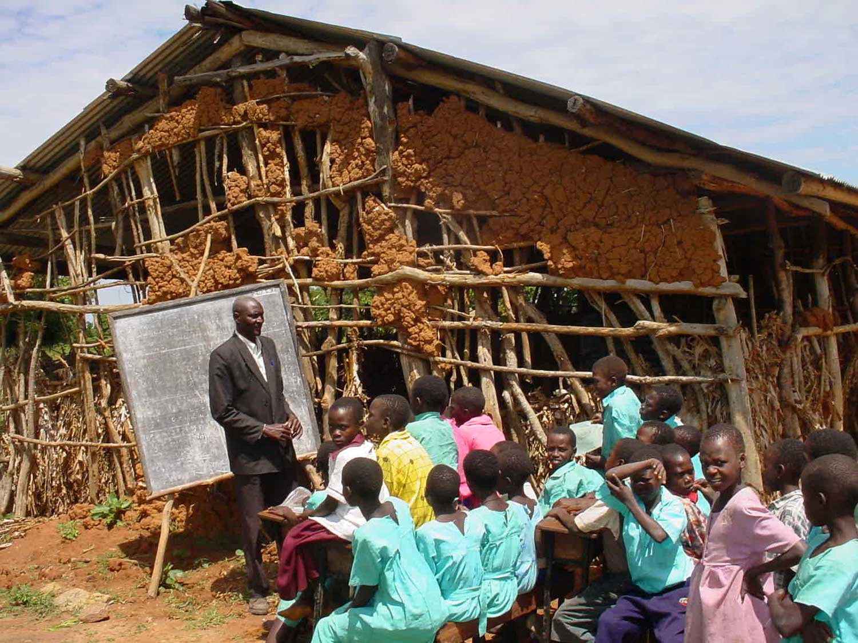
The combination of these issues results in 3 out of 4 pupils dropping out before completing primary school and only 20% achieving recommended competency levels in literacy and numeracy
Notes:
In Kenya 87.38% of the adult population (people over age of 15) can read and write.
Male: 90.62%
Female: 84.18%
In Uganda 73.21% of the adult population (people over age of 15) can read and write.
Male: 82.63%
Female: 64.59%
* World Data Bank 2010

Slide 19
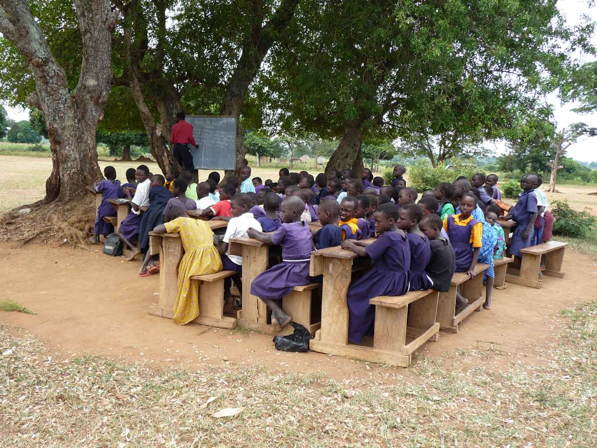
Yet, despite all of these challenges children in Kenya
and Uganda are desperate to go to school and learn
Notes:
Despite these conditions, African children desperately want to go to school.

Slide 20
We want to ensure that rural children receive a quality education in a safe and secure environment that provides them with the knowledge, skills and competencies to continue to learn, grow into healthy adults and lead safe and productive lives.
Build Africa works with parents, children, teachers and government education staff to identify the key problems each school faces and prepare a three year 'School Development Plan’.
We then work with the school, the parents and government staff to implement the plan and transform the school by:
Notes:
Not only does Build Africa ensure that schools are built using good quality materials and adhere to government standards, but Build Africa’s involvement with a school encompasses the entire community and encourages empowerment and ownership by both students and parents for a long time to come.
By supporting a school for at least 7 years, and monitoring it until it is financially self-sufficient, Build Africa can give the school the best possible chance that once the opportunity of education has been provided, it is not taken away.

Slide 21
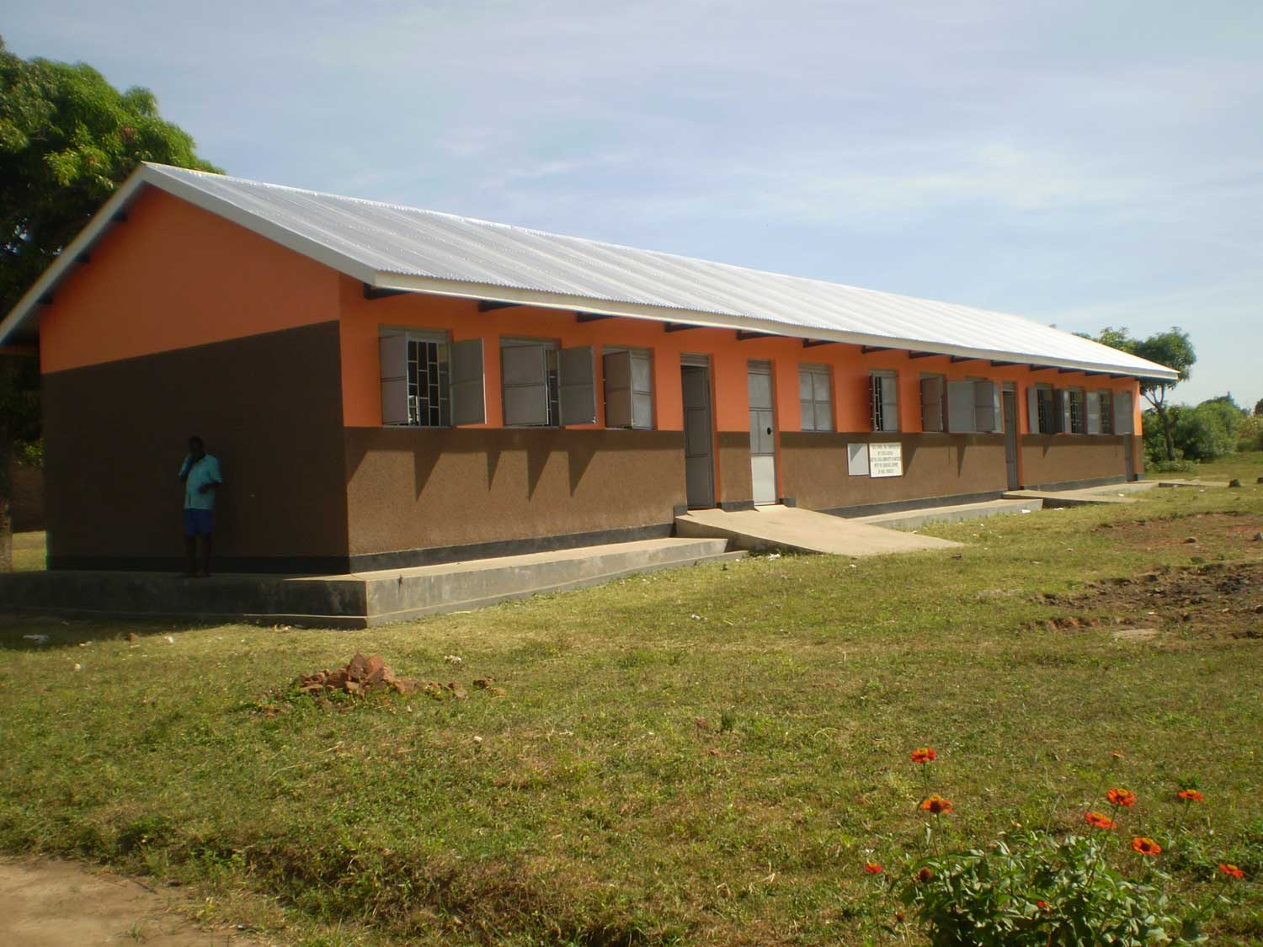
Improving infrastructure
Notes:
The value of a classroom is not just the bricks and mortar but what happens inside of it.
A safe, secure classroom means that children keep up with their studies and have a much better chance of reaching their final year of primary school and passing their leaving exams.
In the rural schools supported by Build Africa in 2012, 47% pupils taking their primary exams achieved a grade eligible for secondary school. (38% Kenya and 51% in Uganda).

Slide 22
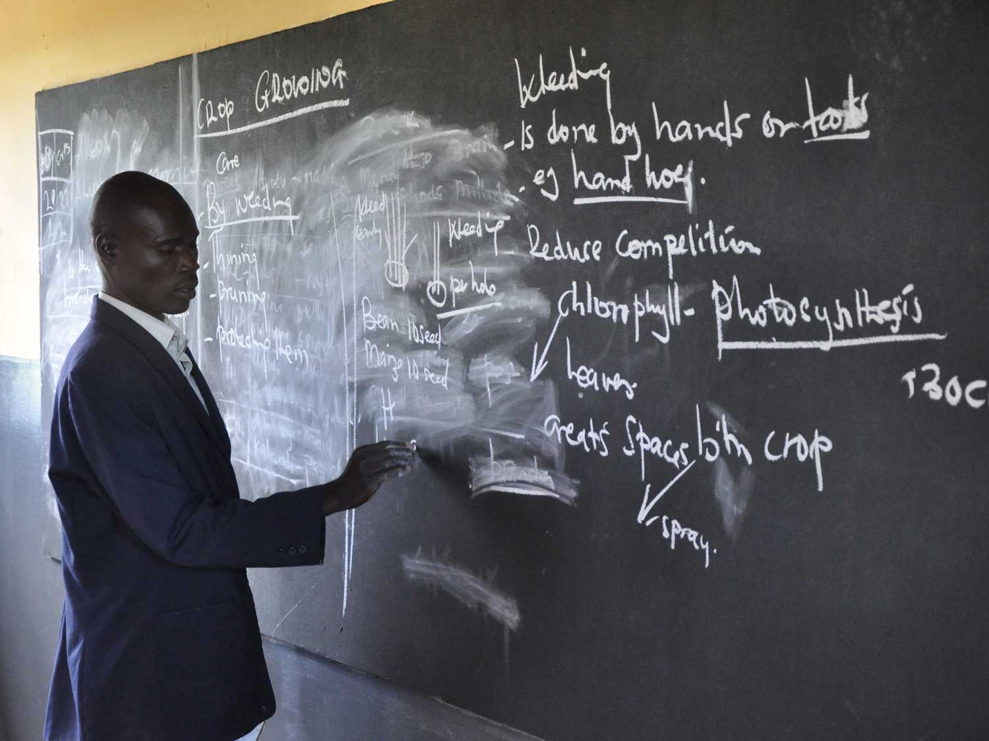
Improving standards of teaching and learning
Notes:
Teachers become empowered, motivated and enthused when they learn new skills and strategies and have experienced good practice from observing good teaching and learning in action in well-performing schools.
In the 2011 to 2012 period, we trained 396 teachers in 82 schools on child-centred teaching methods and how to set their own practice exams.
By supporting teachers we not only help to provide the education that pupils deserve, but allow teachers develop their teaching careers.
There are 974 teachers in schools supported by Build Africa of which 41% are female. Of the 355 teachers in Kenya 50% are female and 35% of the 619 Ugandan teachers are female.
The average number of pupils to teachers across all schools supported by Build Africa is 52 (32 in Kenya and 62 in Uganda).

Slide 23
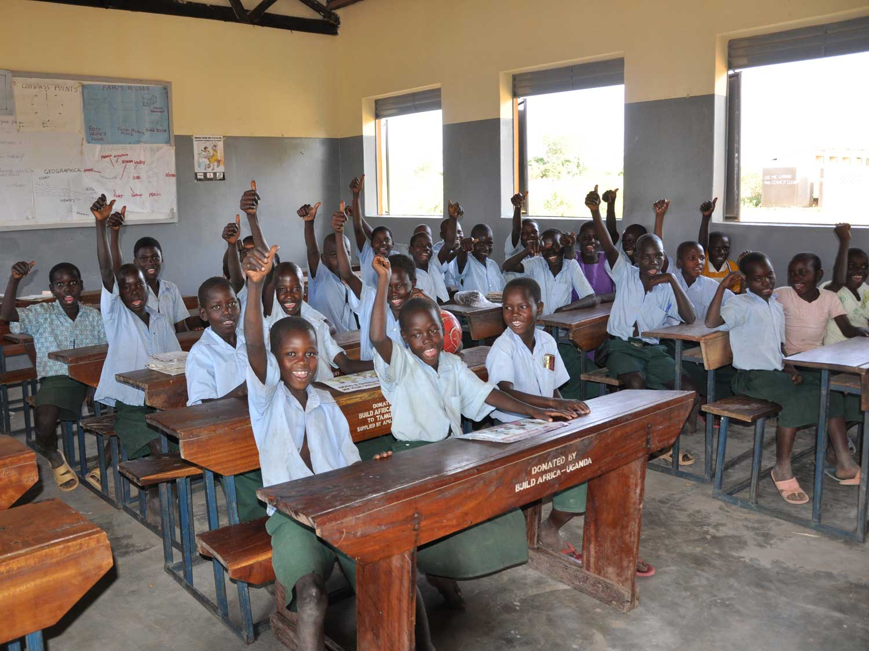
Improving conditions for learning through the
provision of desks and chairs
Notes:
In schools supported by Build Africa 87% of pupils are adequately seated (88% in Kenya and 86% in Uganda).
In 2012 Build Africa supported 49,850 pupils in 103 schools in Kenya and Uganda, achieving a remarkable average attendance in excess of 80%.

Slide 24
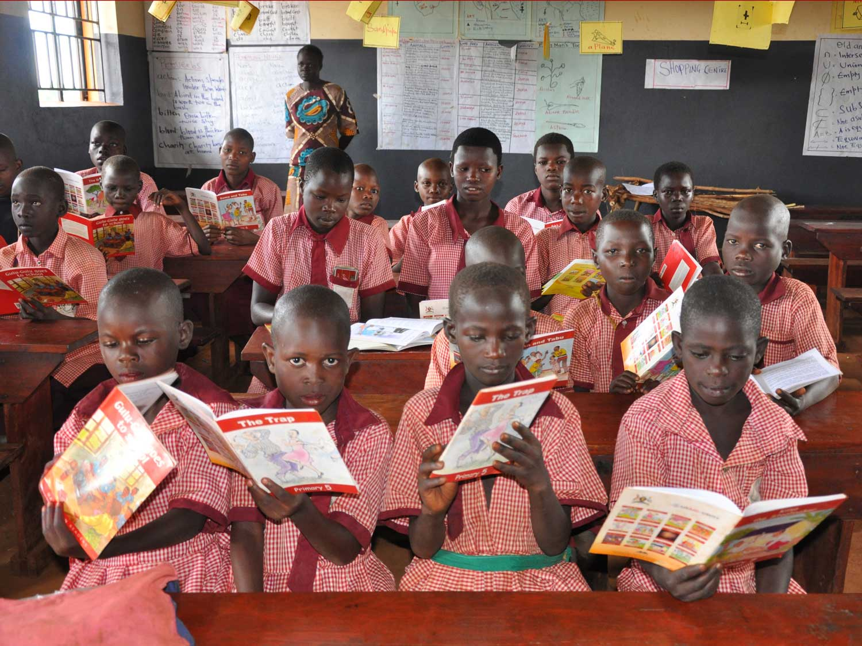
And providing adequate teaching aids and resources
Notes:
Adequate teaching materials allows teachers to deliver their message effectively to pupils.

Slide 25
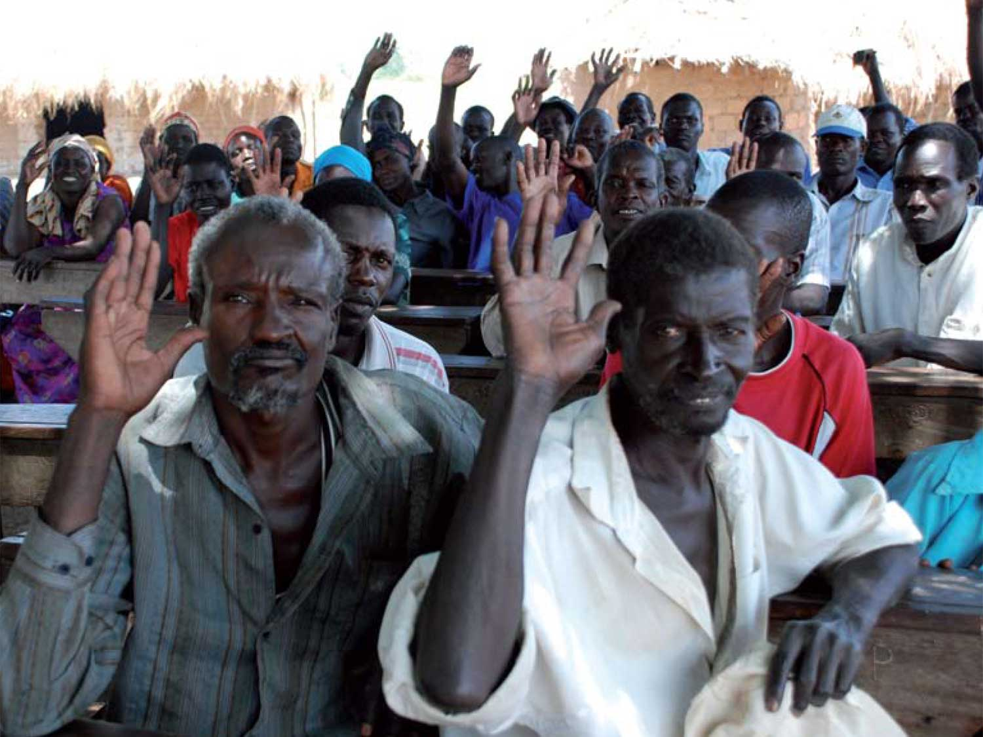
As well as working to increase parental involvement
Notes:
By supporting teachers, parents and pupils as they develop a three year School Development Plan communities become engaged, empowered and take ownership of the school itself and their children’s education.
We pay special attention to ensuring that communities understand their right to a good education for their children.
In 2011 we ensured that 78 schools had comprehensive, custom built School Development Plans to guide their future development.

Slide 26
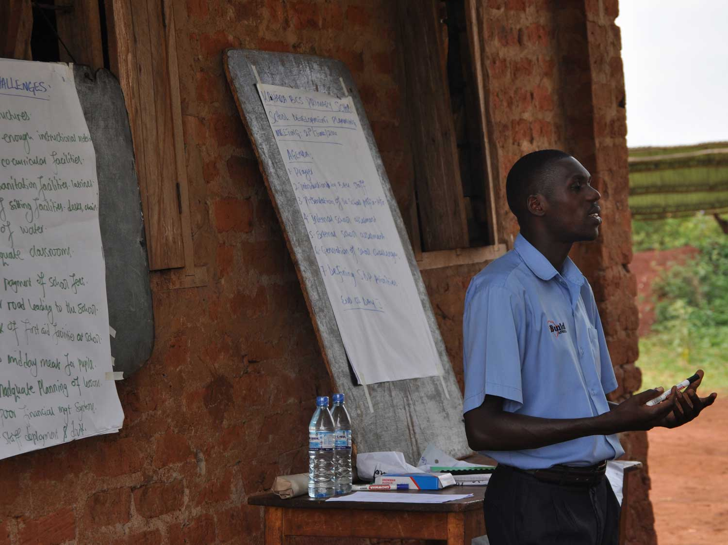
And strengthening school management committees
through training and mentoring activities
Notes:
Build Africa trained 440 School Management Committee (SMC) members in 2011 – 2012 (212 in Uganda and 228 in Kenya) to assist them better manage and govern the school, including accessing the resources they're entitled to.
Around 56% of the SMC members trained in Kenya and 26% of those trained in Uganda were female.

Slide 27
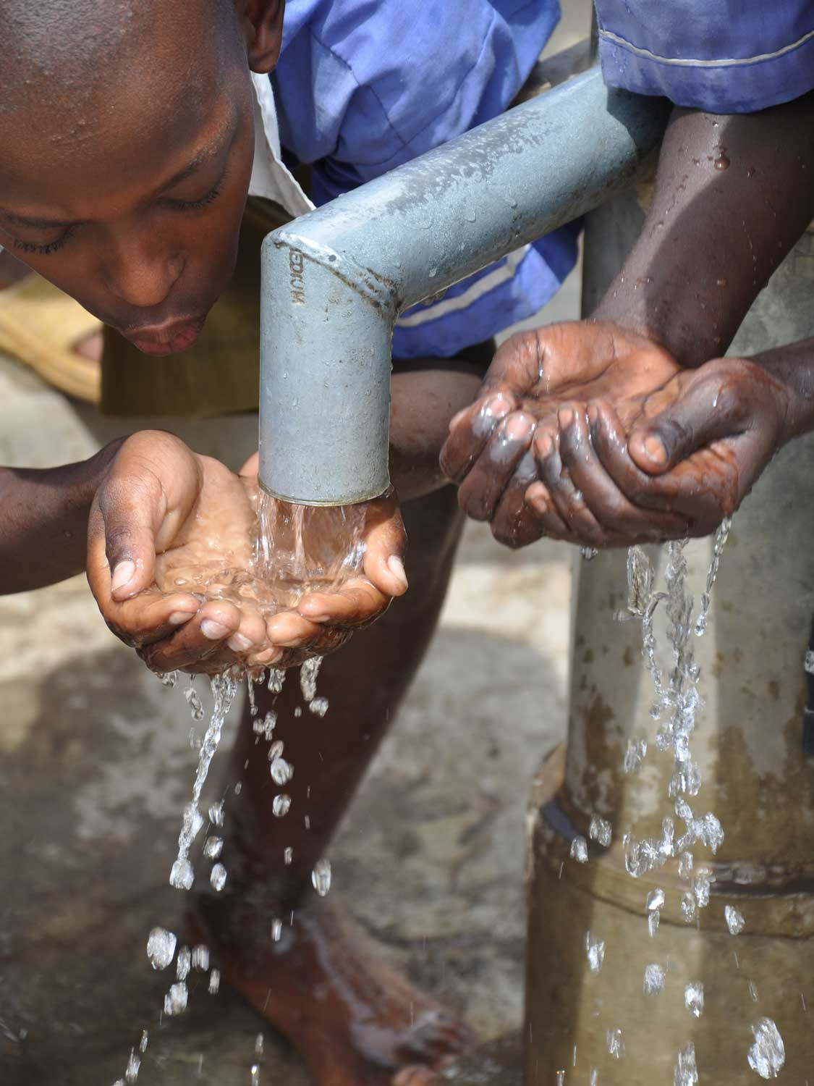
Ensuring access to safe clean water supplies by digging boreholes, providing water tanks
and guttering
Notes:
All of the efforts of the children, teachers and parents are undermined because their fundamental right to clean and safe drinking water is not being fulfilled.
A borehole would change everything, helping children to avoid diseases, and in the long run, stay in school and complete their education
Build Africa prevents water sources becoming a burden on the local community by completing a thorough assessment of the viability and sustainability of a borehole before it is installed.
Once a borehole has been built, community members are trained to maintain it and a maintenance kit is provided so that all the necessary tools are available.
A water committee is established or an existing one is developed so that the community can effectively plan how the borehole will be managed and the long term monitoring of the school is extended to the borehole ensuring this infrastructure is sustainable.
This means that any borehole constructed by Build Africa will supply rural communities with safe, clean drinking water over a sustained period of time and limit the threat of disease.

Slide 28
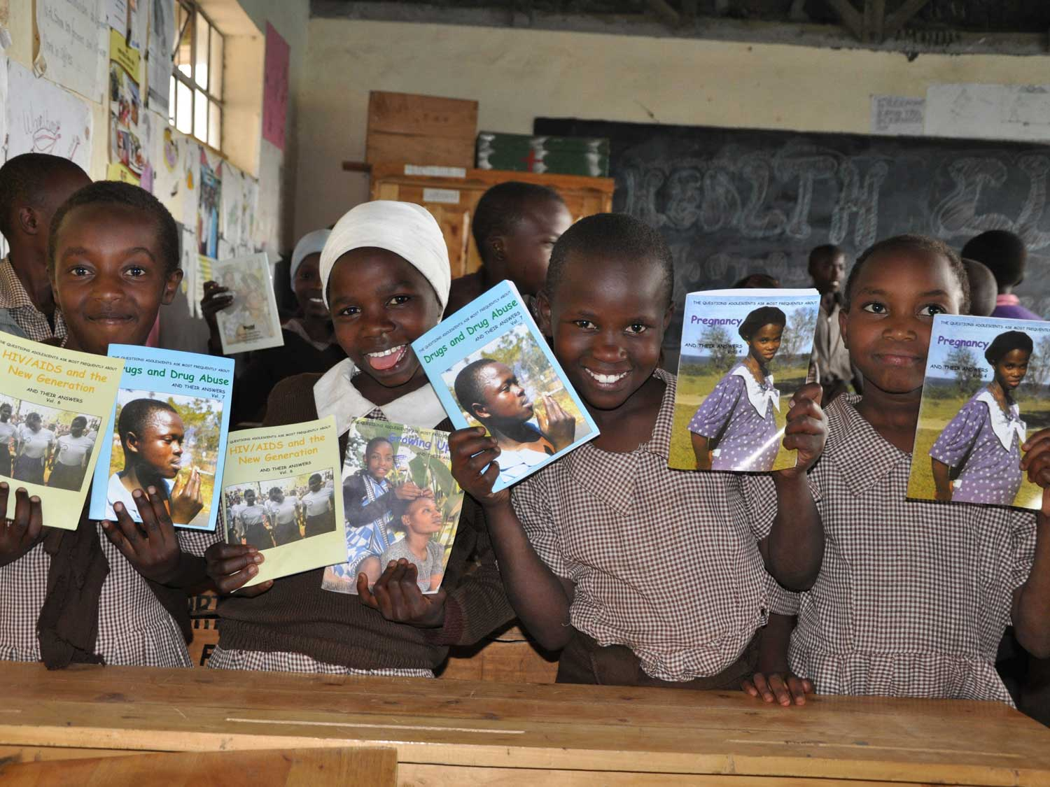
Increasing health, gender and HIV and AIDS awareness
through health clubs and peer educators
Notes:
In the 2011 to 2012 period, we trained 161 adult peer educators and 265 child peer educators.
Build Africa helps schools to develop a health club to promote health and hygiene training, and provide educational materials along with awareness about routine treatment of parasitic infections.
We also work hard to ensure girls access the education they are entitled to, providing training on menstrual health and sanitary towels to all girls when needed, thus improving their school attendance and education opportunities.
Teachers are trained in child protection, gender and disability.

Slide 29
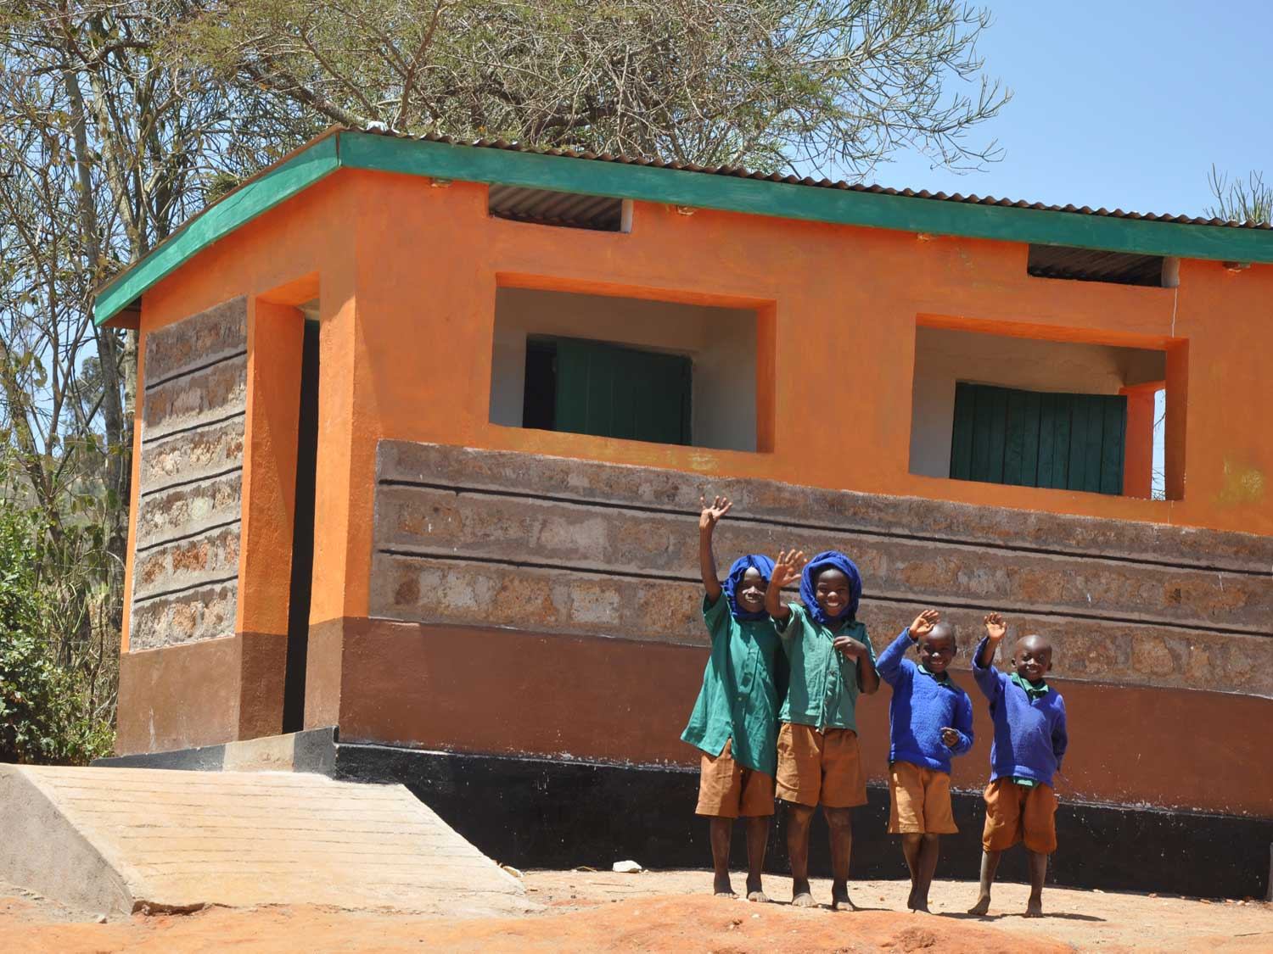
Building new latrines
Notes:
There are effective and practical solutions we can implement to ensure that poor sanitation facilities do not lead to sickness and absenteeism. Both are serious threats to the chances of children receiving a quality education and therefore to their future.
We work to ensure schools have adequate toilets and appropriate hand-washing facilities.
Separate and hygienic toilet facilities will improve sanitation levels, decrease sickness and ensure that girls have the privacy they need.
A simple handwashing solution need not be expensive and we are working with schools encouraging them to place suitable facilities next to all their toilets.

Slide 30
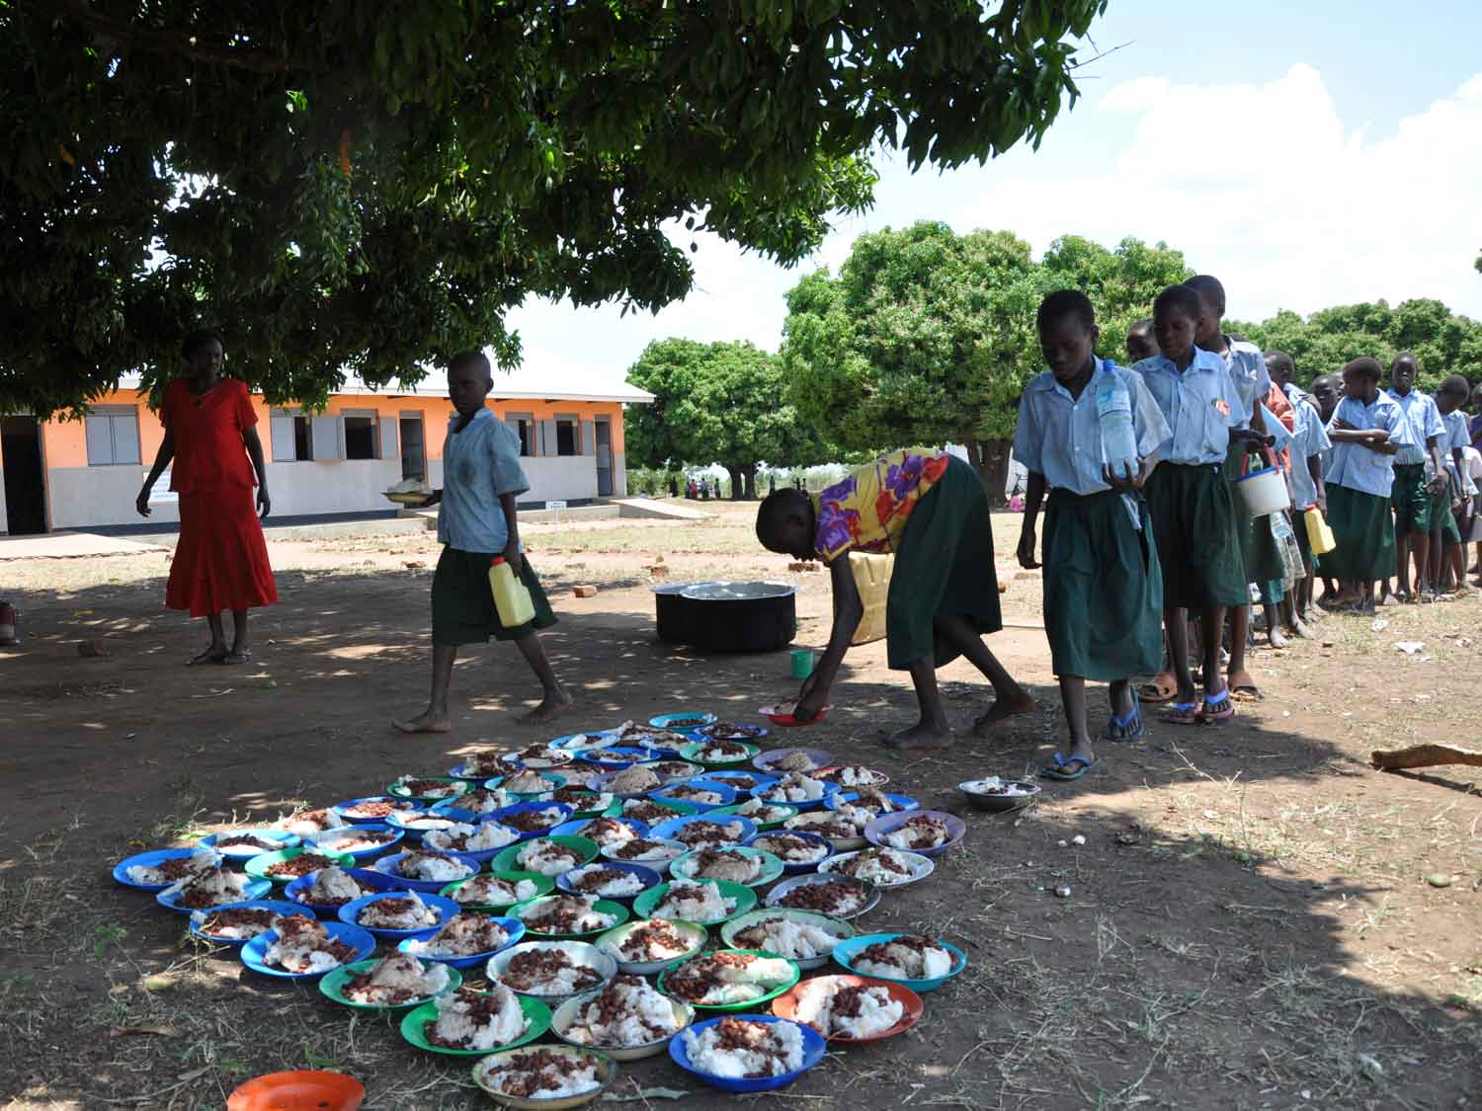
And establishing school meal programmes to
provide at least one meal a day
Notes:
There are simple and sustainable solutions that can help the communities we work with experience improved food security and nutritional levels.
School gardening is an excellent means of teaching children new skills. Children develop an understanding of agricultural productivity and the environmental impact of farming through practical lessons, for example on crop rotation and drought management.
Parents also benefit from learning best practice from their children and from helping in the school demonstration plot. This leads to increased productivity of subsistence farming and decreases the pressure on children to abandon school to support household food and income generation.
School gardens give schools the ability to offer nutritious meals to pupils during the school day, which will lead to improved academic performance.

Slide 31
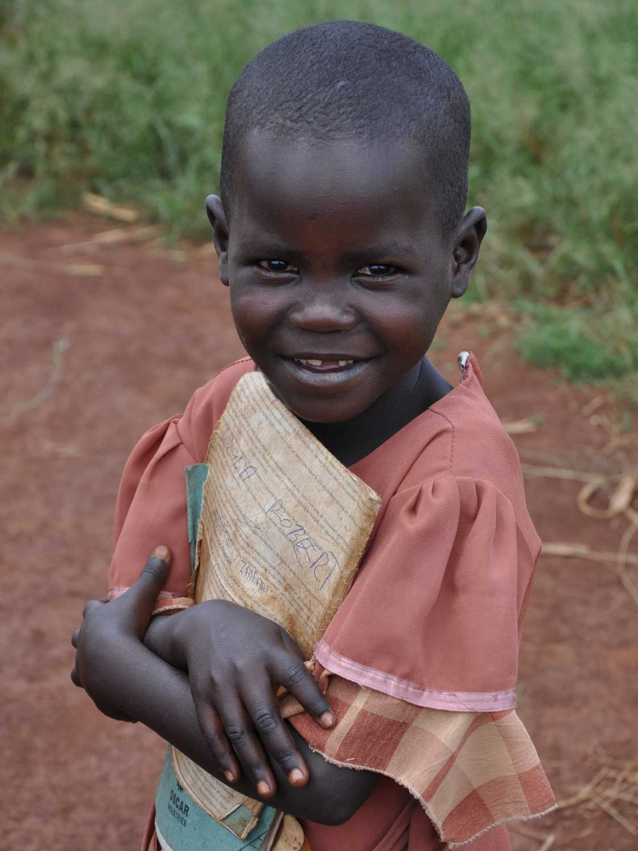
Can you help?
We need your help to
give children in rural
Kenya and Uganda the
same opportunities
that children have
in the UK

Slide 32
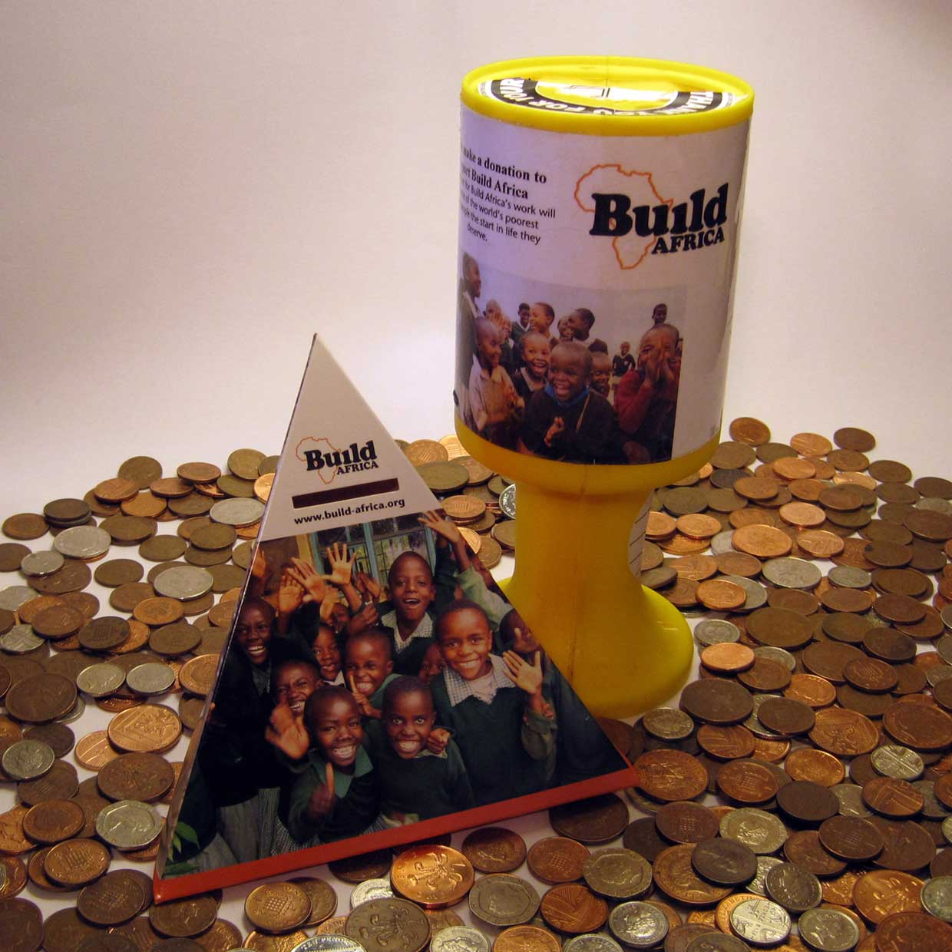
How your school would benefit
Fundraising for
Build Africa provides
an opportunity for
UK pupils to work
together in a practical
and rewarding way

Slide 33
How your pupils would benefit
Our School Fundraising Programme has been developed in consultation with teachers and children across the UK and we have prepared lesson plans for all ages which are closely linked to the national curriculum. Pupils benefit by:
Learning about the cause they are supporting
Gaining a better understanding of the global issues that affect all of our lives
Establishing links between their lives and the lives of those that they are helping
Understanding the work of charities
Developing participation skills and promoting active global citizenship
Working as a team to understand how their individual and collective actions can benefit others

Slide 34
Supporting your fundraising
We have a selection of materials to help your fundraising activities and ensure they are a success
School Fundraising Leaflet A - Z School Fundraising Ideas
Penny Guessing Game Sponsorship Forms
Fundraising Target Poster Blank event posters
Collection Tins Balloons
Notes:
Available to download off the website … http://www.build-africa.org/pages/teachers-resources.html
Or ask us for printed copies of the fundraising pack, as well as Build Africa balloons and collection tins for your events.
Raise awareness about Build Africa
By telling all your family and friends about what we are doing together, more people get to hear about Build Africa and learn about the work we are doing.
The more people who know, the more money we can raise, and the more children we can help to get a good education.
Who knows, with a good education, a future President of Kenya on Uganda may come from a school, helped by the money that you have raised!

Slide 35
Supporting your fundraising
We have also developed free curriculum-based resources to help teachers engage students and ensure they understand the cause they are supporting
Games: Lesson Plans:
Map of Africa Game Primary Key Stage One
Snakes and Ladders Game Primary Key Stage Two
Spot the Difference Secondary Key Stage Three
Presentations for Primary School and Secondary School students
Notes:
Available to download off the website … http://www.build-africa.org/pages/teachers-resources.html
Or ask us for printed copies of the fundraising pack, as well as Build Africa balloons and collection tins for your events.
Raise awareness about Build Africa
By telling all your family and friends about what we are doing together, more people get to hear about Build Africa and learn about the work we are doing.
The more people who know, the more money we can raise, and the more children we can help to get a good education.
Who knows, with a good education, a future President of Kenya on Uganda may come from a school, helped by the money that you have raised!

Slide 36
Every pound makes a difference
Below is a list of costs to give you an idea of what money raised could provide:
£300 could buy 80 textbooks for children desperate to learn
£800 could pay for 7 teachers to receive training on up to date teaching methods
£1,800 could buy 50 desks so that children no longer sit on the floor
£3,400 could pay for 30,000 litre water storage tanks and guttering, giving them enough water to last through times of drought
£10,000 could pay to build and furnish an entire classroom
Whether you are planning a one off event or would like to develop a long-term partnership with an African school, we will work closely with you and provide all the information you need to keep pupils, parents and teachers engaged and motivated.

Slide 37
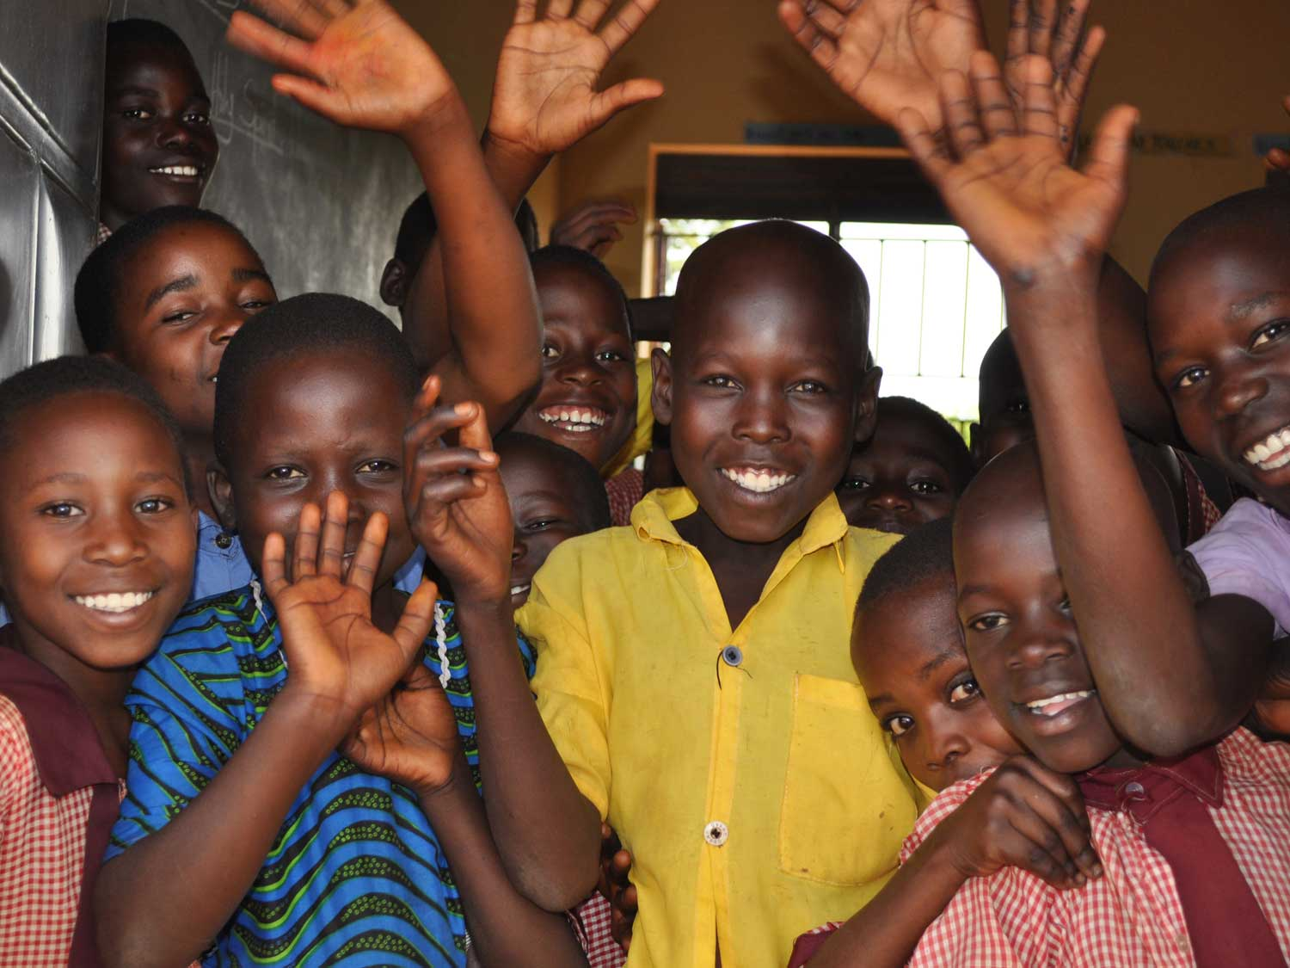
The more money you raise for Build Africa
the more people we are able to help

Slide 38
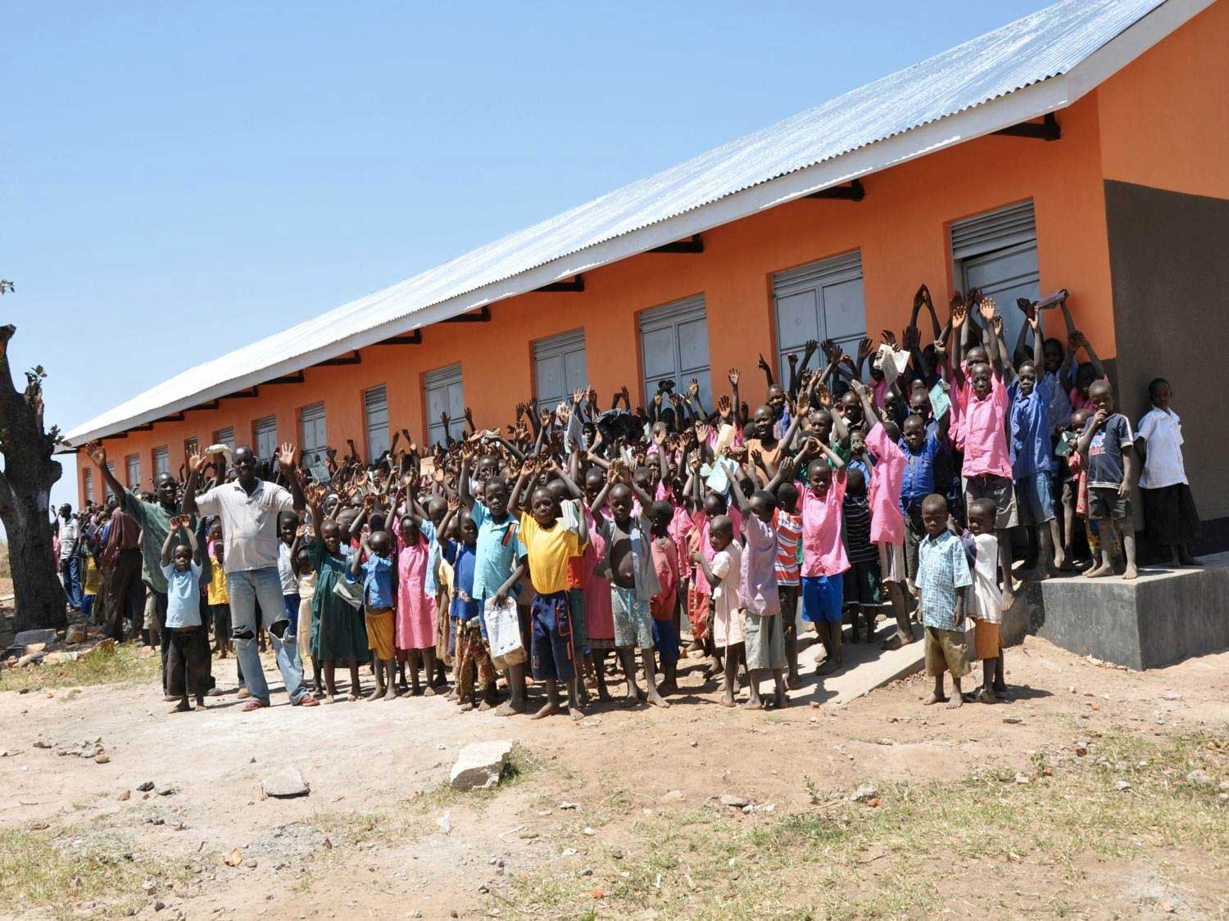
Because every pound raised really does make makes a difference!

Slide 39
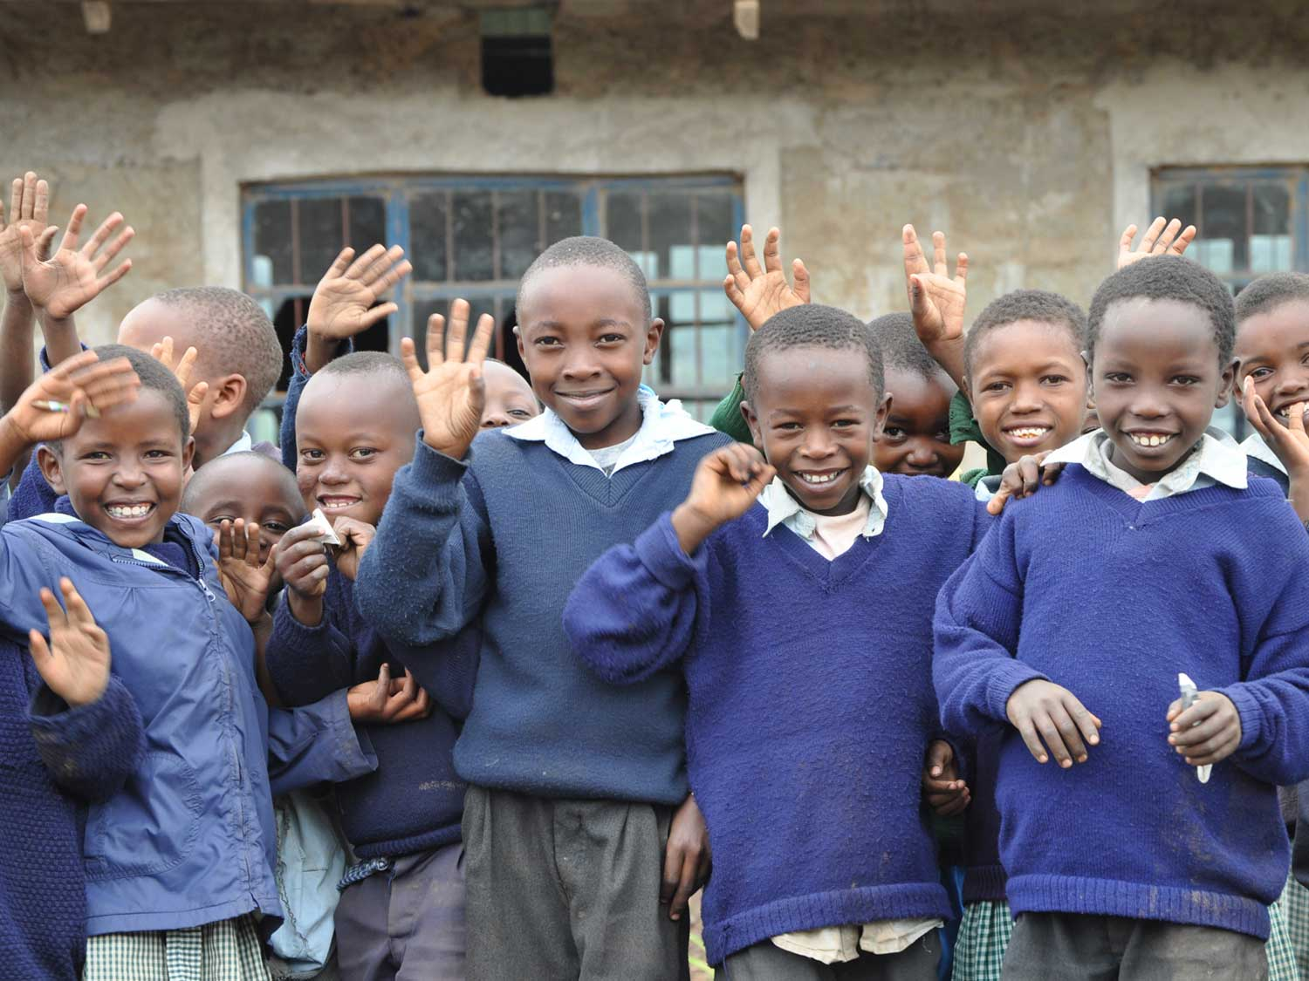
Asante!
Thank You!
Notes:
Thank you!

Slide 40
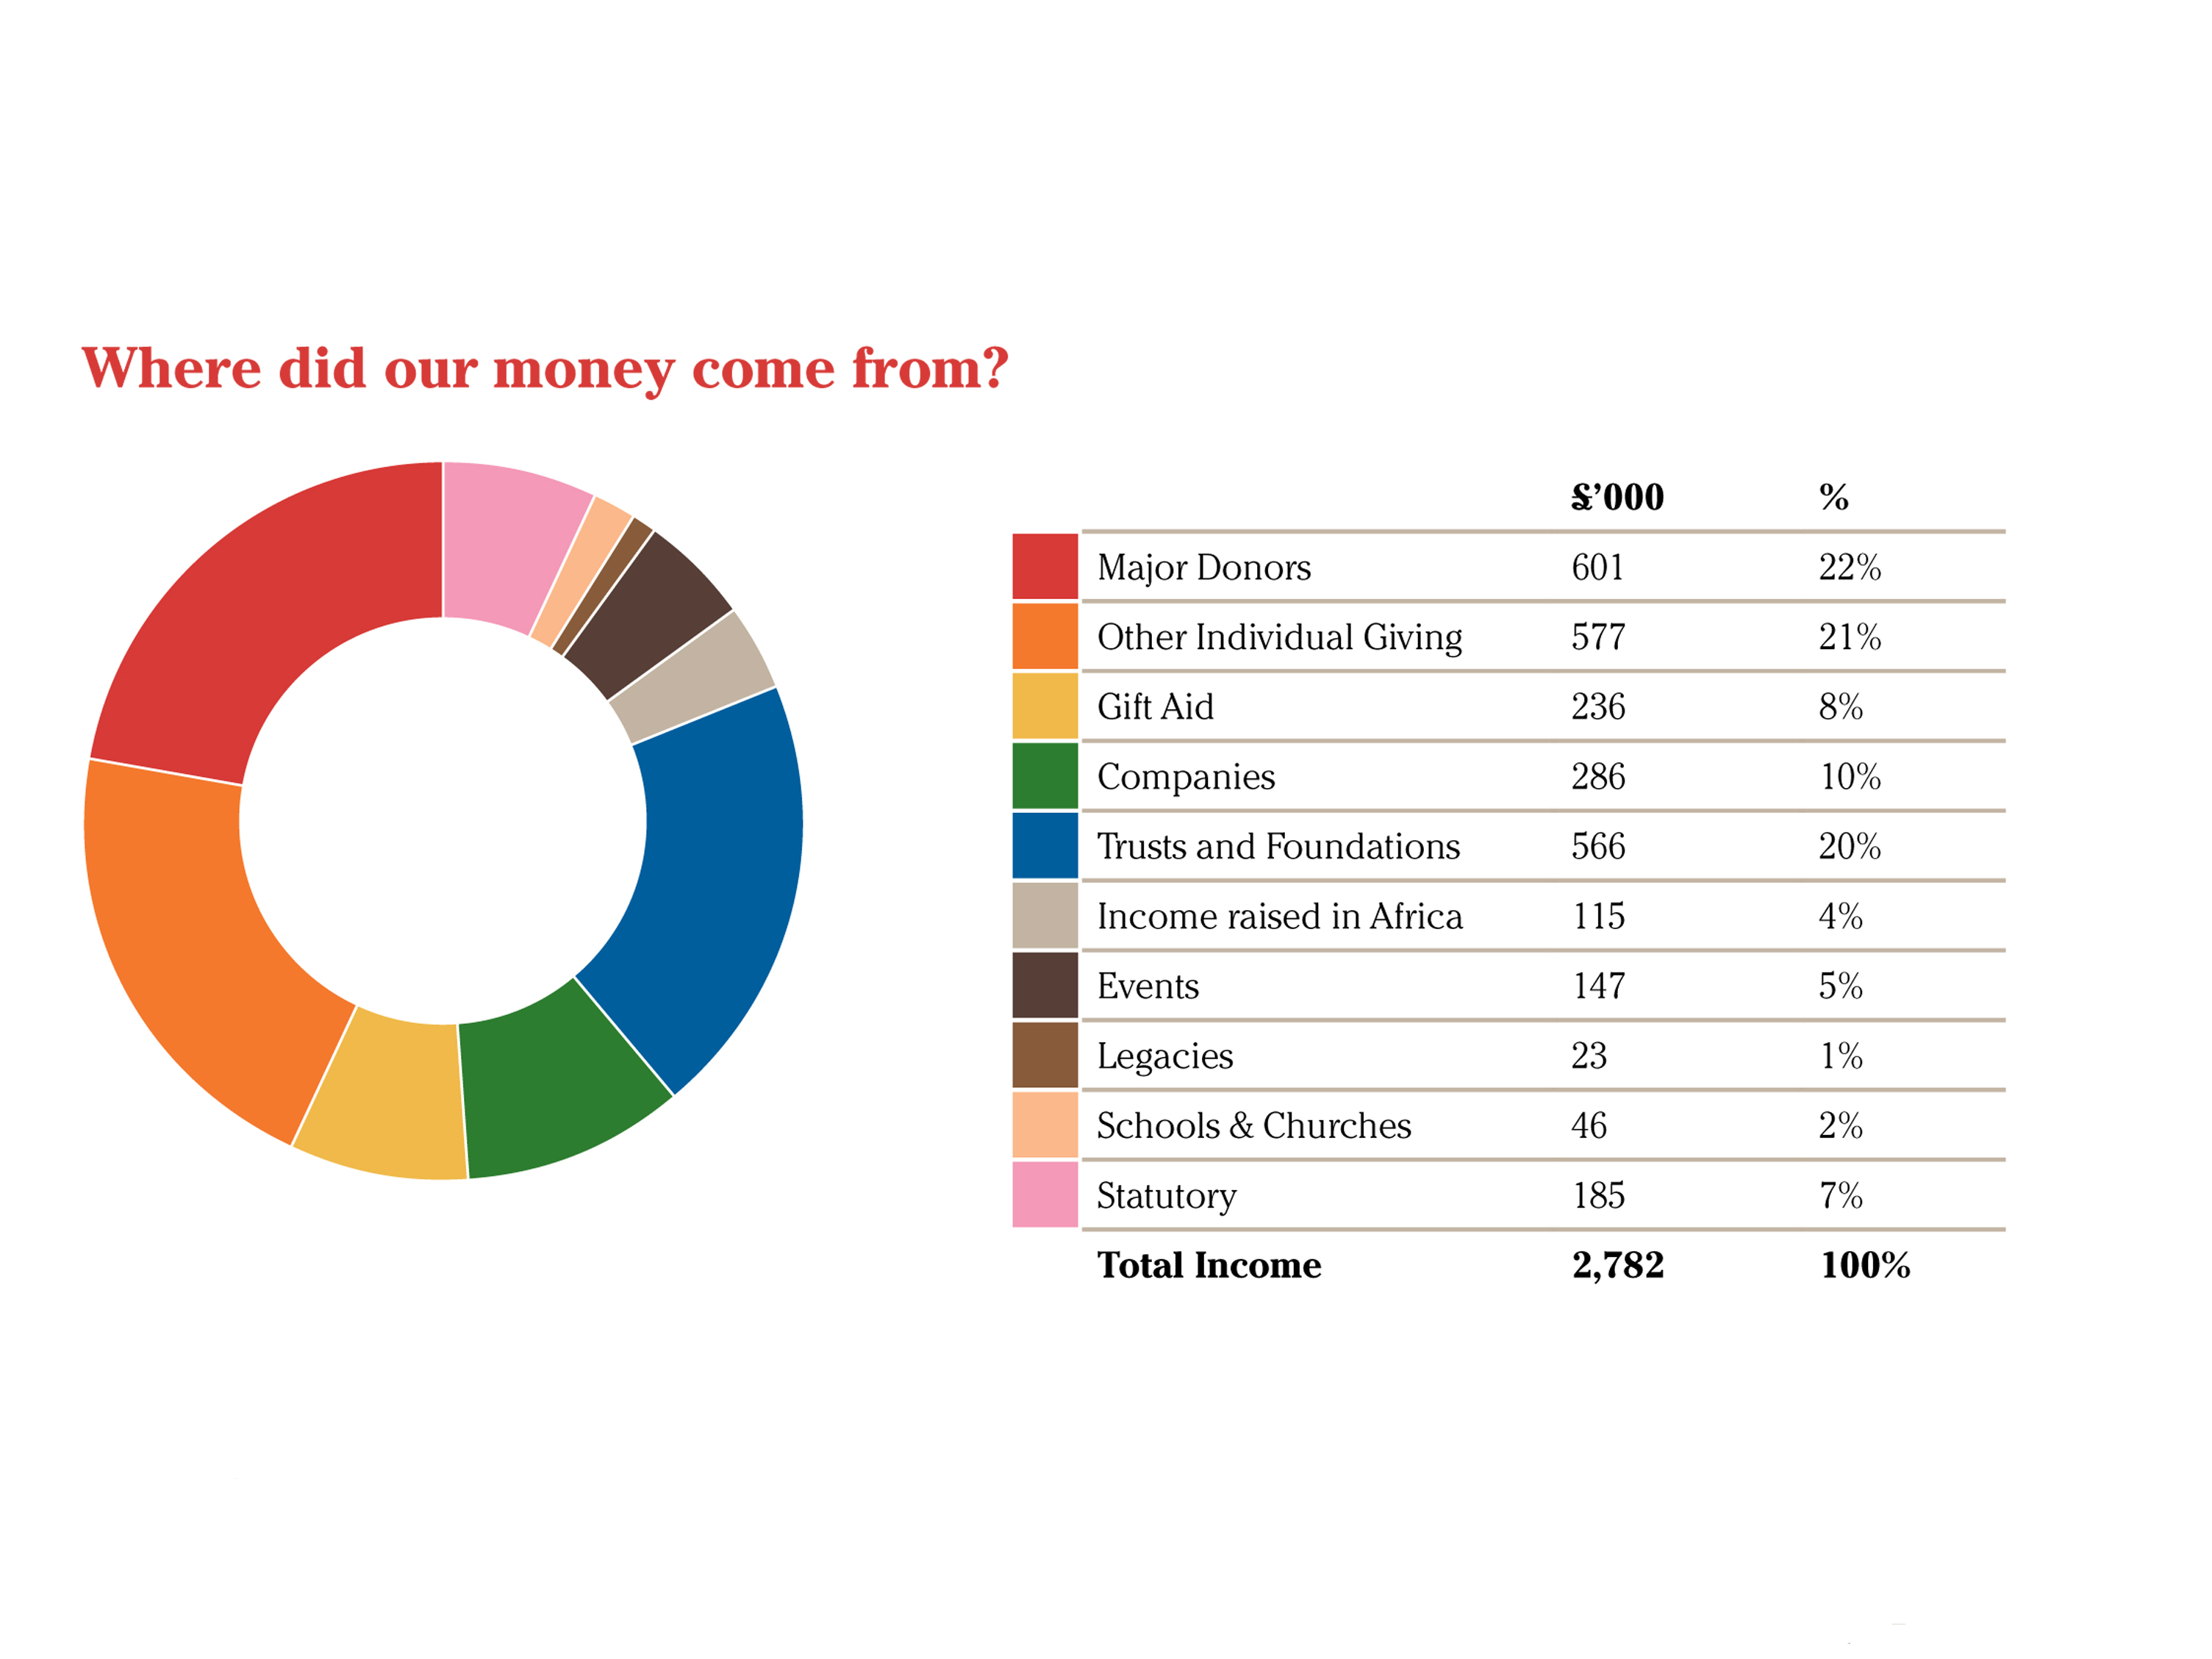
Finances 2012
Notes:
Download the 2012 Review
http://www.build-africa.org/pages/annual-review.html
For a fuller understanding of the financial affairs of the charity please request a copy of the comprehensive Annual Report and audited Consolidated Financial Statements.
A copy of the full Annual Report and audited Accounts have been filed with the Charity Commission.

Slide 41
Finances 2012
Notes:
Download the 2012 Review
http://www.build-africa.org/pages/annual-review.html
For a fuller understanding of the financial affairs of the charity please request a copy of the comprehensive Annual Report and audited Consolidated Financial Statements.
A copy of the full Annual Report and audited Accounts have been filed with the Charity Commission.

Slide 42
For more information about fundraising for a school in Africa
please contact Deirdre Bruce-Brand on 01892 519619
or email schools@build-africa.org.uk
Notes:
Any questions?
For more information about fundraising for a school in Africa please contact Deirdre Bruce-Brand on schools@build-africa.org.uk or 01892 519619.

