Slide 1
Lesson Question:
Why is it so important that children learn?
What if you were in charge?
Look at the pictures.
Choose the one you would work on.

Slide 2
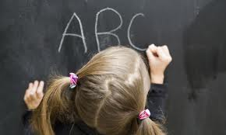
I believe we should make sure all children
can go to primary school.
Reading and writing means we can take care of our own life.

Slide 3
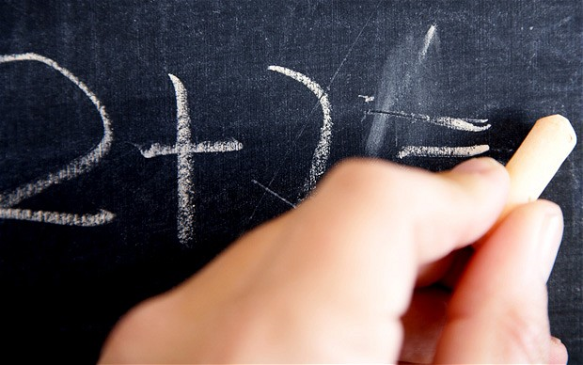
I believe we should make sure all children
can go to primary school.
Doing maths means we can understand what we have
and what we need.

Slide 4
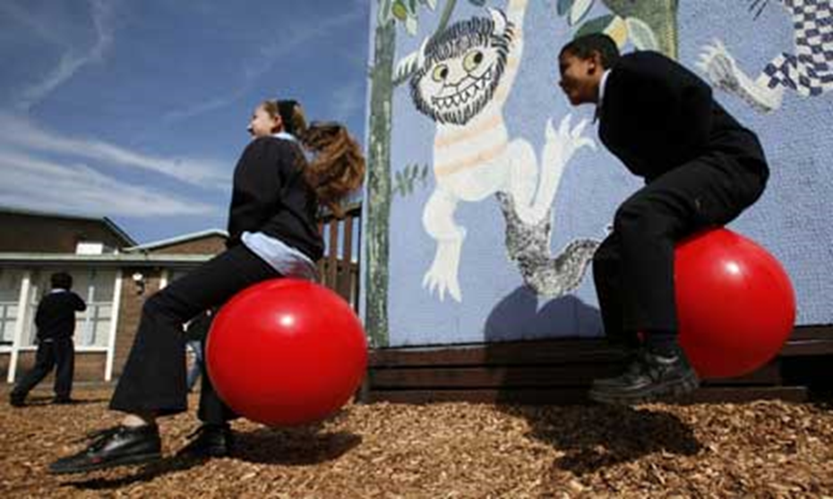
I believe we should make sure all children
can go to primary school.
Learning to makes up happy.

Slide 5
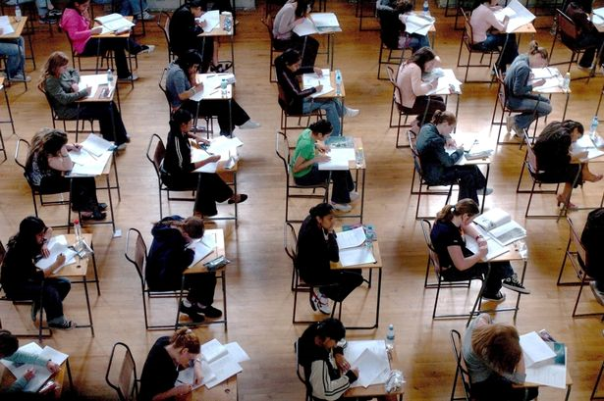
I believe we should make sure all children
can go to primary school.
They might carry on learning.

Slide 6
Task: Draw a picture.
The picture should show the reason you
think every child should to to school.

Slide 7
Task: Look at the pictures on the wall.
Talk to each other about what the pictures
tell us about going to school.

