Slide 1
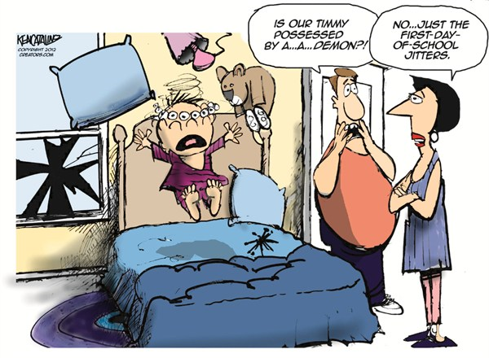
Lesson Question:
How is learning in Africa different to how we learn?
Task: Can you remember what you were afraid of before you started school?

Slide 2
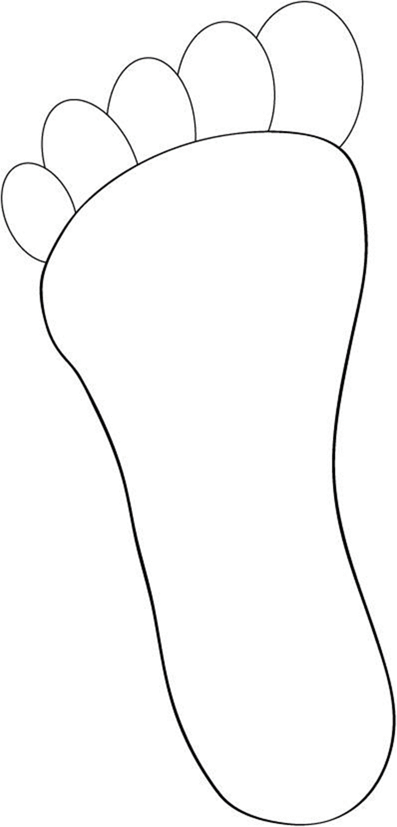
How many steps do we take
to school? Let’s investigate?

Slide 3
In one of the footsteps draw a picture of something you see on your way to school

Slide 4
How many footsteps would Joseph and Sarah take to school when they live between 5km - 8km away?

Slide 5
In one of the footsteps draw something that Joseph and Sarah would see on their journey to school in Uganda.

