Slide 1
Lesson Question:
How would we like to be treated?
Happy
Safe
Upset
Angry
How would you feel if … ? Think: Why?

Slide 2
In this room we should … ? Think: Why?

Slide 3
In this room we should … ?
Our best ideas!

Slide 4
In this room we should … ? What should be our rules?

Slide 5
In this room we should … ? What should be our rules?
Democracy is …

Slide 6
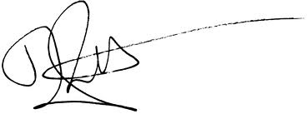
By signing we all agree to being treated
in this way in this classroom.

