Slide 1

Lesson Question:
Why is it so important that children learn?
Task: What if you were in charge?
Look at the five pictures. Put the pictures into order of the most important to the least important.
Right down the reasons for your choices.

Slide 2
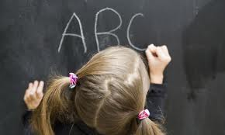
I believe we should make sure all children
can go to primary school.
Reading and writing means we can take care of our own life.

Slide 3

I believe we should make sure all children
can go to primary school.
Doing maths means we can understand what we have
and what we need.

Slide 4
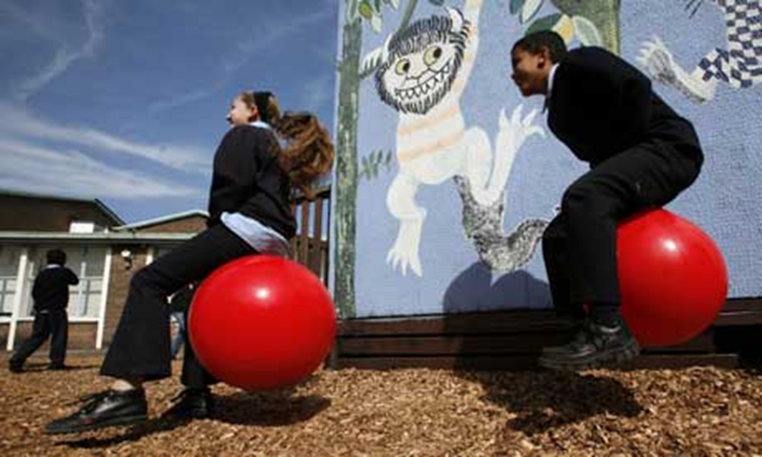
I believe we should make sure all children
can go to primary school.
Learning to makes up happy.

Slide 5
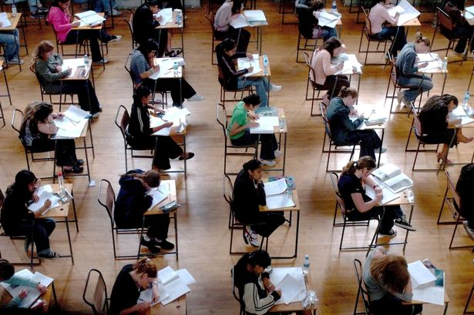
I believe we should make sure all children
can go to primary school.
They might carry on learning.

Slide 6
Task: Produce a poster promoting education
for all the children in the world.
Challenge: Can you look into education
around the world and find examples to
put on your poster?

Slide 7
Task: Look at the posters on the wall.
Talk to each other about what the posters
tell us about going to school around the world.

