Slide 1
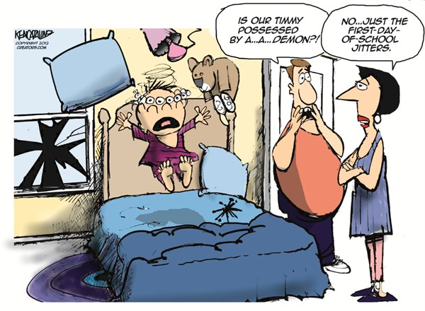
Lesson Question:
How is learning in Africa different to how we learn?
Task: Can you remember what you were afraid of before you started school?

Slide 2
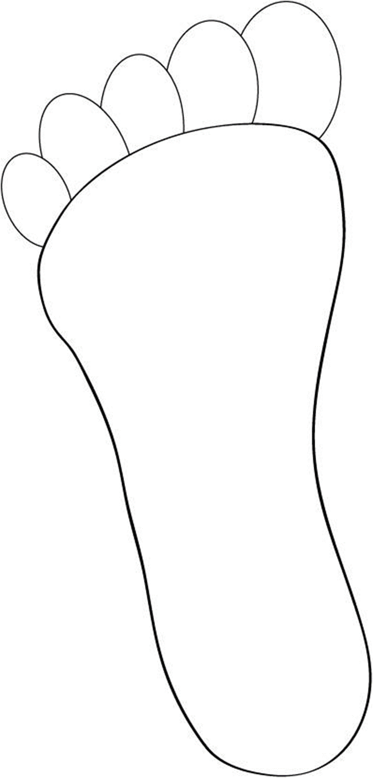
Think: How can we work out the average number of steps we take?
How many steps do we take
to school? Let’s investigate?

Slide 3
In one of the footsteps draw a picture of something you see on your way to school

Slide 4
Think: How can we work out how many steps they took?
How many footsteps would Joseph and Sarah take to school when they live between 5km - 8km away?

Slide 5
Think: How can we find out what it is like in rural Uganda?
In one of the footsteps draw something that Joseph and Sarah would see on their journey to school in Uganda.

Slide 6
However
Also
Similarly
Yet
Both
On the other hand
Task: Using some of these connectives, write three sentences to say how going to school in Africa is the same or different to going to school in the UK.

