Slide 1
Lesson Question:
What is important about the United Nations Rights of the Child?
Think: Why should we believe we have rights?

Slide 2
Task: Read the Articles that lay out the rights of the child. What are the rights of a child? Write one right per sticky note.

Slide 3
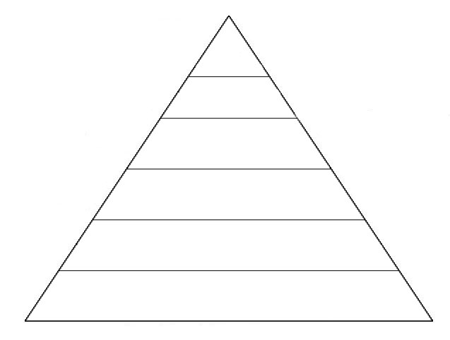
What should we aspire to … ?
Task: Organise your sticky notes into a pyramid. At the bottom all those rights that are important to life.
At the top, the right that we must reach for if the world is to be a better place.
What is the foundation of life … ?

Slide 4
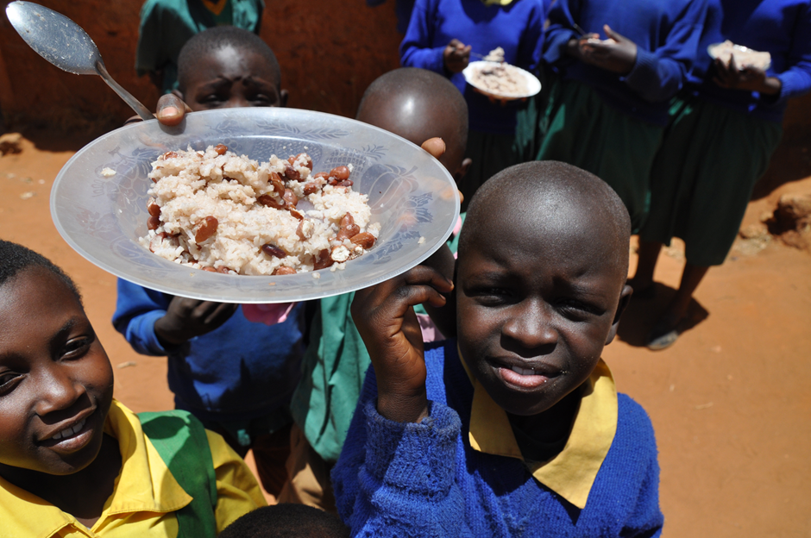
Think: If all children had rights then there would be no need for these articles to be written
Task: For the article you have been given decide
a) what gets in the way of children having this right and b) what can be done to put this right?

Slide 5
Task: Present your ideas to the class. As you listen, make notes on other people’s ideas.

Slide 6
Task: Summarise the actions we should take to improve the rights of the child.

